Slide 1

Introduction & The Big Picture
Why System Design?
HLD vs LLD
Requirement Gathering
OOP Analysis
SOLID Principles
Synchronization
Case Study

Slide 2
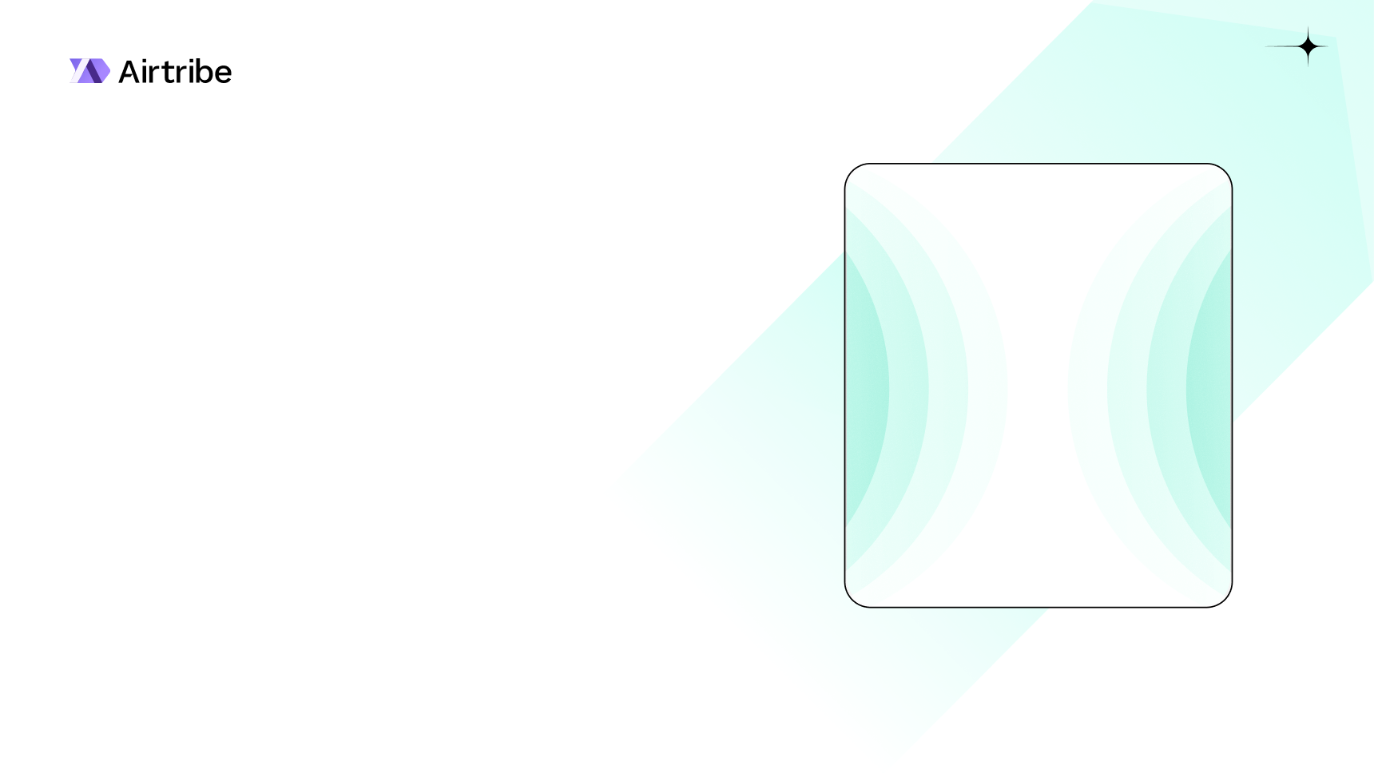

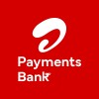
Meet your instructor
Kajal is currently working as an SDE 3 at Airtel Payments Bank, where she builds scalable backend systems and innovative software solutions. She has strong expertise in Spring Boot, Redis, Apache Kafka, Microservices, and MySQL. With hands-on industry experience in designing high-performance backend architectures, Kajal is passionate about mentoring aspiring engineers and sharing practical insights into building robust, real-world backend systems.
Kajal Glotra SDE - III @

Slide 3

Why Do We Need System Design?
System design helps us build scalable, maintainable, and reliable software systems instead of writing random code.
Without design, systems become messy, slow, and hard to maintain.
1️⃣ To Handle Large Scale Systems
2️⃣ To Manage System Complexity
3️⃣ To Improve Scalability
4️⃣ To Ensure Maintainability
5️⃣ To Improve Performance
6️⃣ To Handle Concurrency
7️⃣ To Build Reliable Systems

Slide 4

High Level Design VS Low Level Design
Feature | High-Level Design (HLD) | Low-Level Design (LLD)
Alternative Name | System Design / Macro Design | Detailed Design / Micro Design
Primary Goal | Define the architecture and components. | Define the internal logic and class structure.
Scope | Entire System / Multiple Services. | Individual Module / Component.
Components | Databases, Queues, Caches, APIs. | Classes, Methods, Attributes, Loops.
Outcome | Architecture Diagram. | Class Diagram / Sequence Diagram.
Conclusion | How do these systems talk to each other? | How does the code work inside one system?
Words | Scale, load, system down, bottlenecks | Classes, logic, Relationships

Slide 5
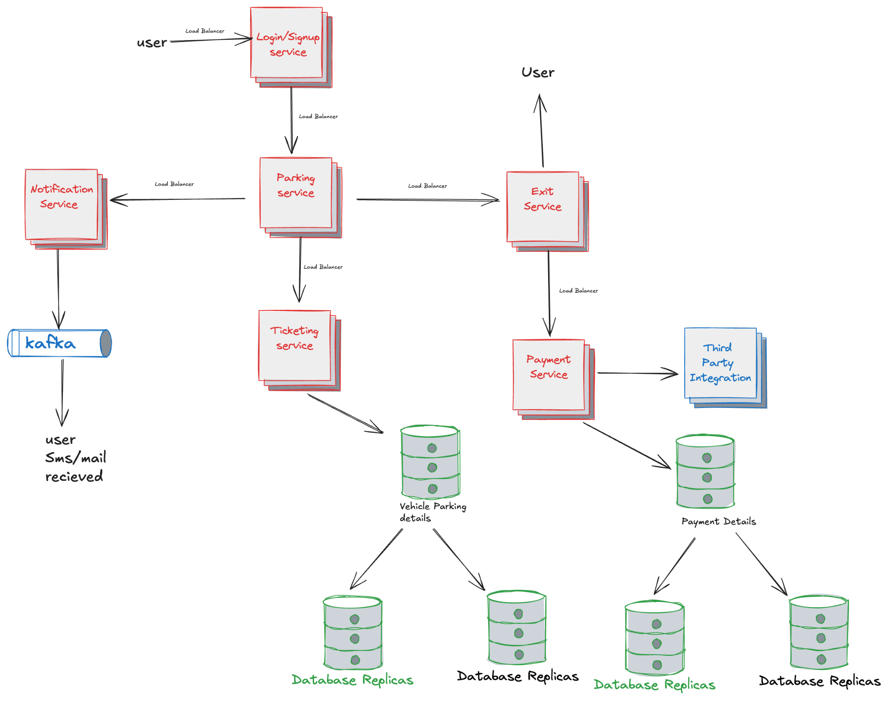
HLD(Architecture)

Slide 6

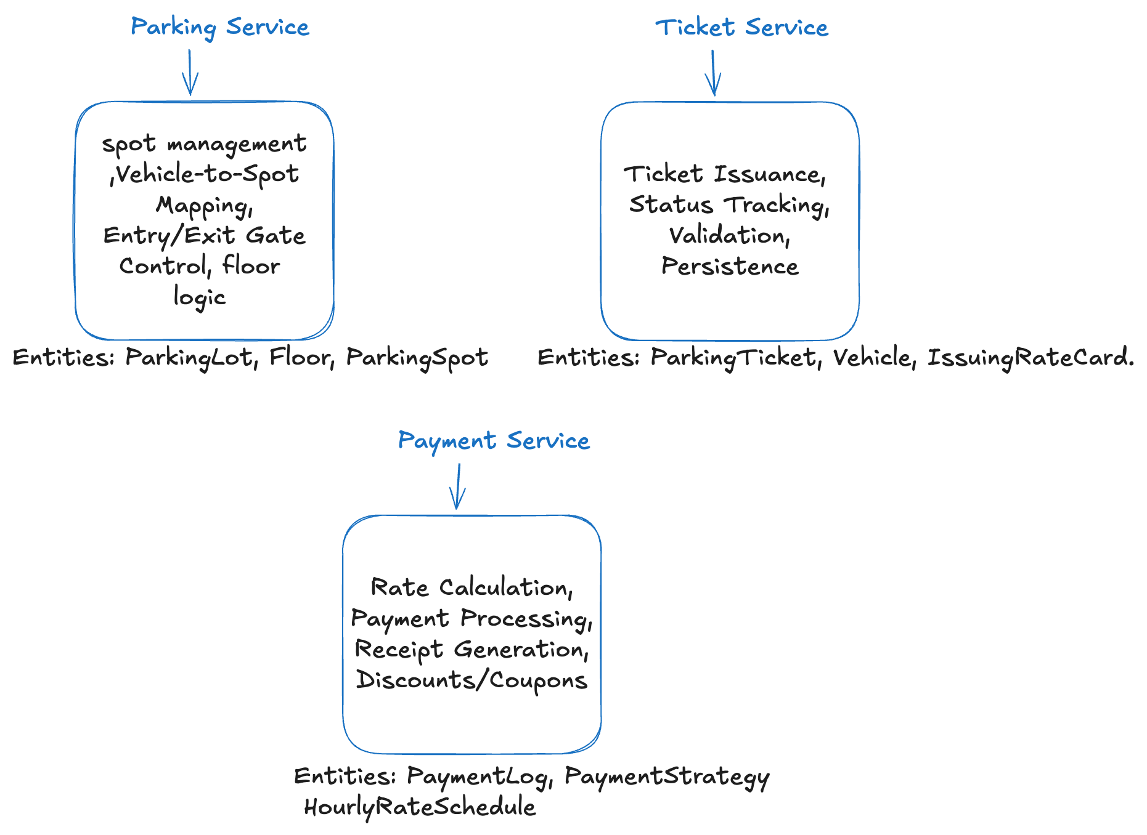
LLD(Components Implementation)

Slide 7
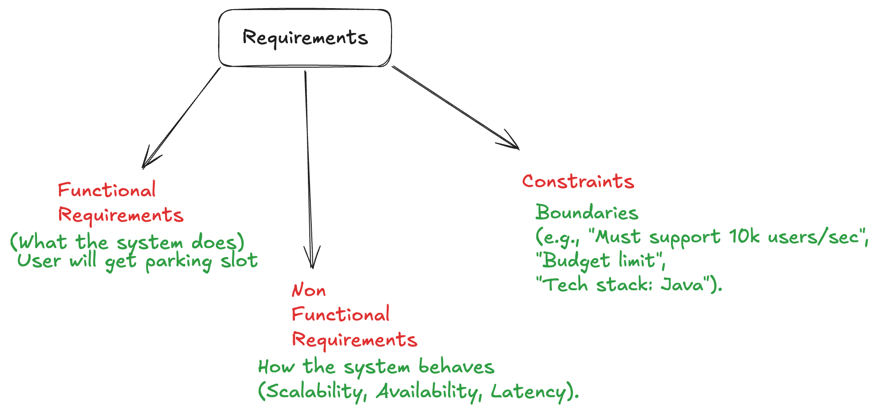
Phase 1 - Requirement Gathering
Lets see different types of requirements for different systems like parking lot, movie ticket booking system, food delivery application etc.

Slide 8
Requirements for Parking Lot System
The system should allow vehicles to enter the parking lot.
The system should allocate an available parking slot based on vehicle type.
The parking lot has a fixed number of parking slots.
A vehicle can only occupy one slot at a time.
The system should handle high traffic during peak hours.
The system should have high availability (99.9% uptime).
The system should generate a parking ticket when a vehicle enters.
The system should calculate parking fee when the vehicle exits.
The system should process payment using multiple payment methods.
The system should ensure secure payment transactions.
The system should release the parking slot after payment.
The system should send notifications (SMS/email) after ticket generation or payment.
The system must store data in the organization’s approved database.
Notifications must be sent through existing messaging infrastructure (Kafka).

Slide 9
OOPS Oriented Analysis
How to identify objects from a problem statement:
Nouns are usually Classes (e.g., Vehicle, ParkingLot, ParkingFloor, EntryPanel, ExitPanel, Account, User, ParkingTicket, RateCard, Payment etc).
Verbs are usually Methods (e.g. findAvailableSlot(VehicleType type), updateSlotStatus(String slotId, SlotStatus status), isFull(VehicleType type), getParkingFloorStats(int floorId), getTicket(Vehicle vehicle), printTicket(ParkingTicket ticket), scanTicket(String ticketId), createTicket(Vehicle v, ParkingSlot s), calculateDuration(String ticketId) etc).
Relationships: Is-A (Inheritance) vs. Has-A (Composition).
Is-A (Inheritance): CompactSlot is a ParkingSlot, LargeSlot is a ParkingSlot, MotorbikeSlot is a ParkingSlot, Car is a Vehicle, Truck is a Vehicle, CreditCardPayment is a Payment
has-A (Inheritance): ParkingLot has many ParkingFloors, ParkingFloor has many ParkingSlots, EntrancePanel has a TicketPrinter, ParkingTicket has a Vehicle (associated with it), ParkingTicket has a ParkingSlot (assigned to it), Account has a Person (storing name, email, etc.)

Slide 10
How SOLID Is Implemented?
S (Single Responsibility): A class should do one thing only. {We have created multiple classes instead of one}
O (Open/Closed): Open for extension, closed for modification (Use Interfaces). {one more vehicle come, we can extend it with vehicles}
L (Liskov Substitution): Subtypes must be substitutable for their base types. {all methods in Vehicle should be implemented in Car class}
I (Interface Segregation): Don't force a class to implement methods it doesn't use. {IExitService, IPaymentService are 2 independent interfaces}
D (Dependency Inversion): Depend on abstractions, not concretions. {We are dealing with interfaces instead of classes}

Slide 11
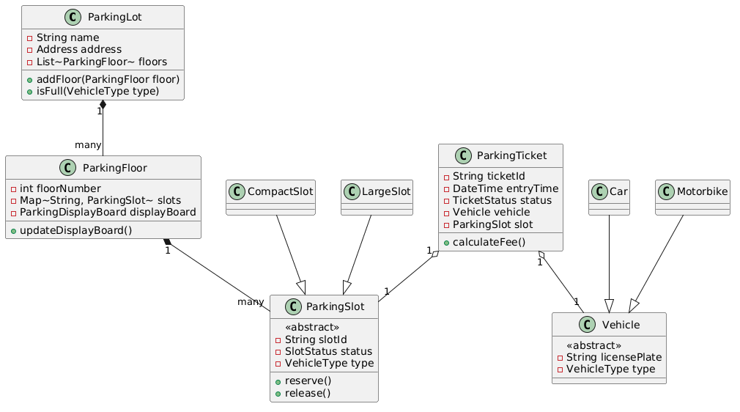
Classes To Understand The System Better

Slide 12
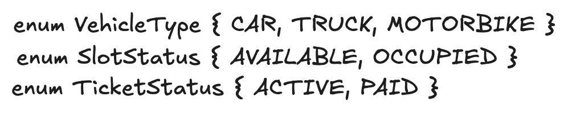
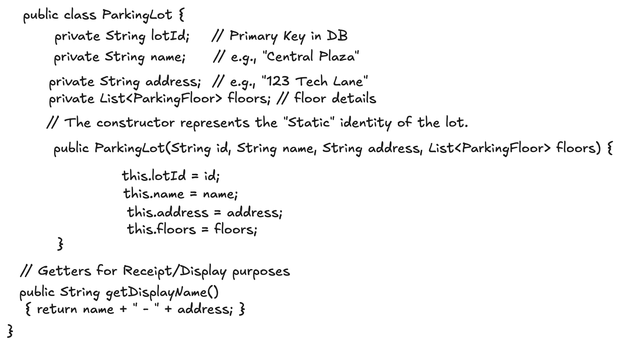
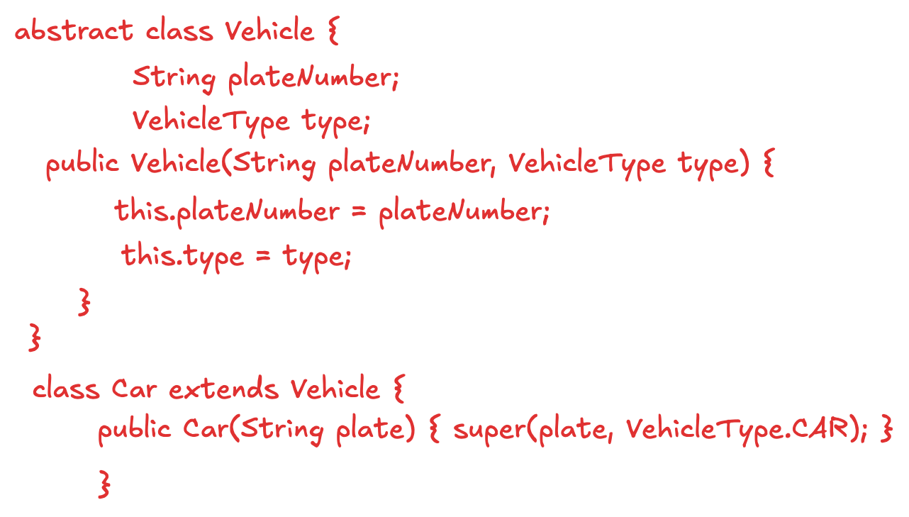
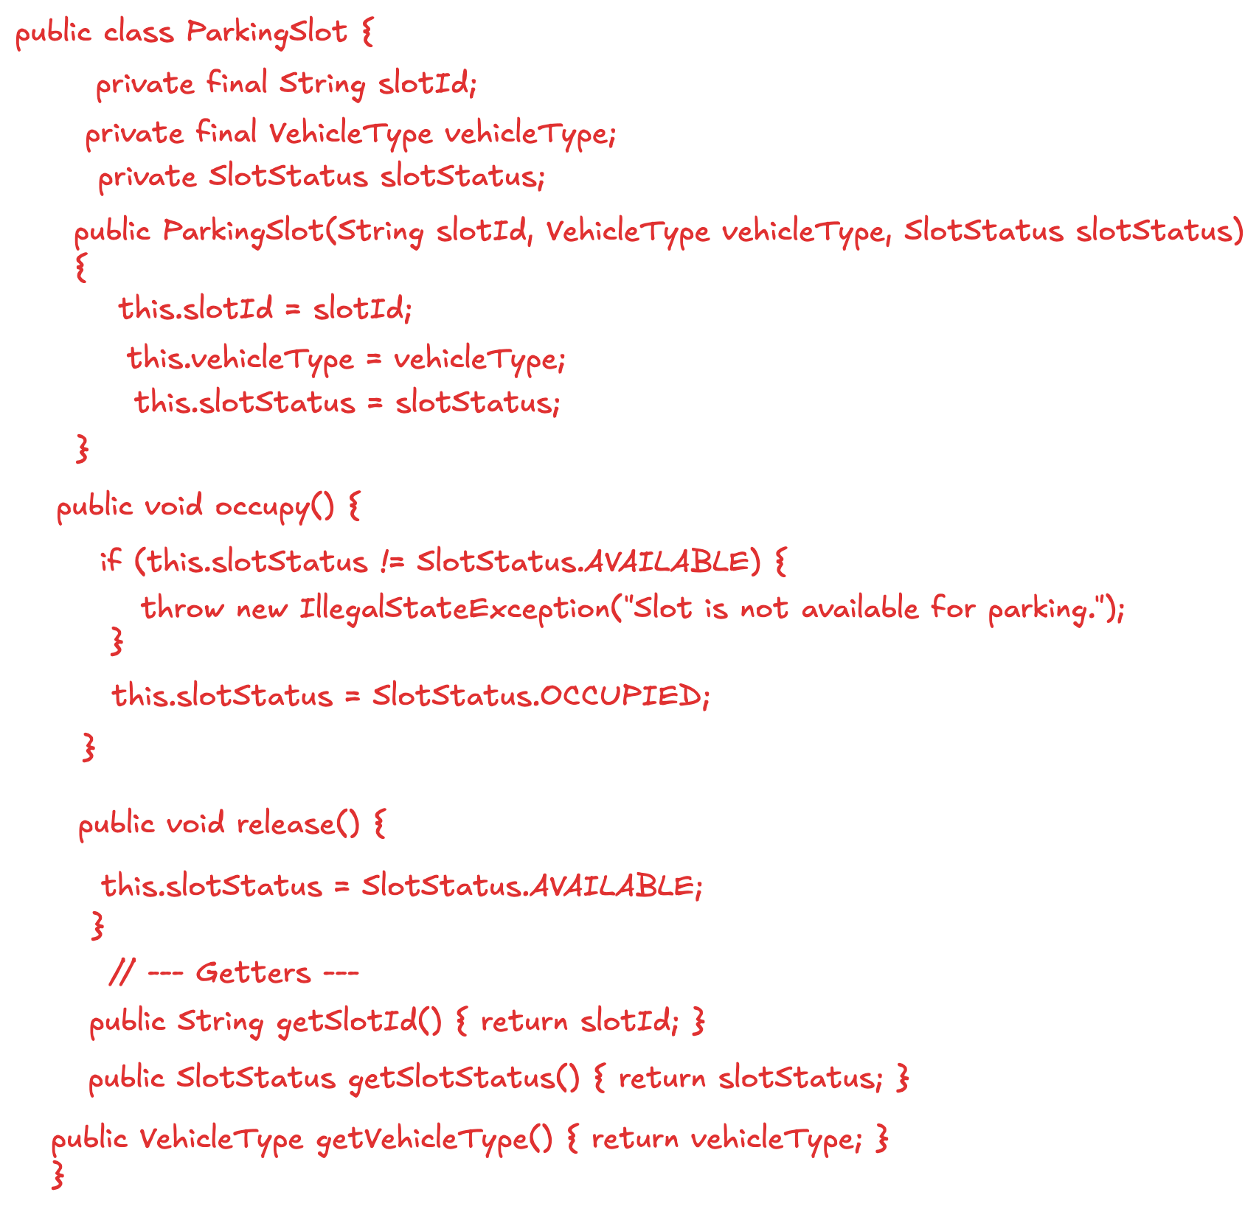
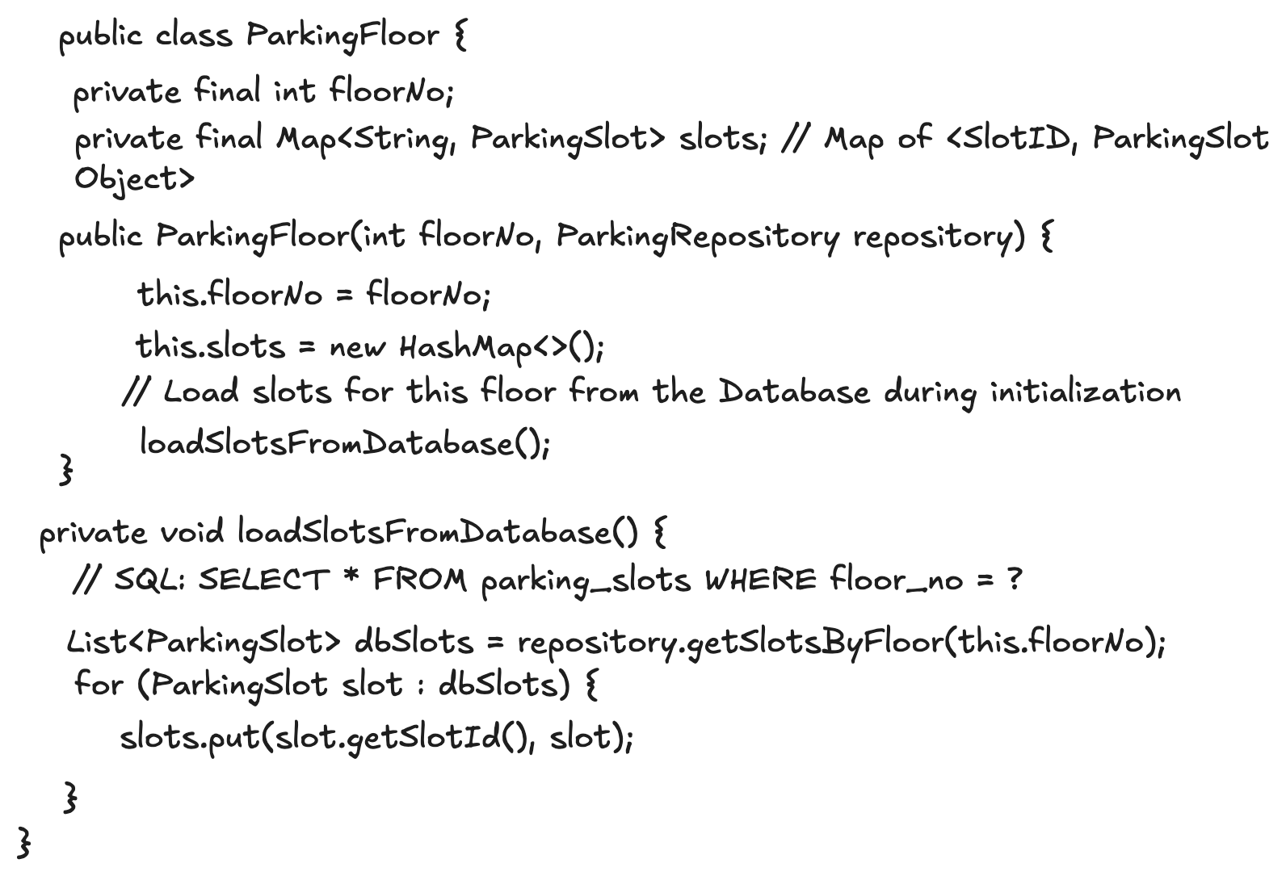
Functionality With Solid Principles

Slide 13
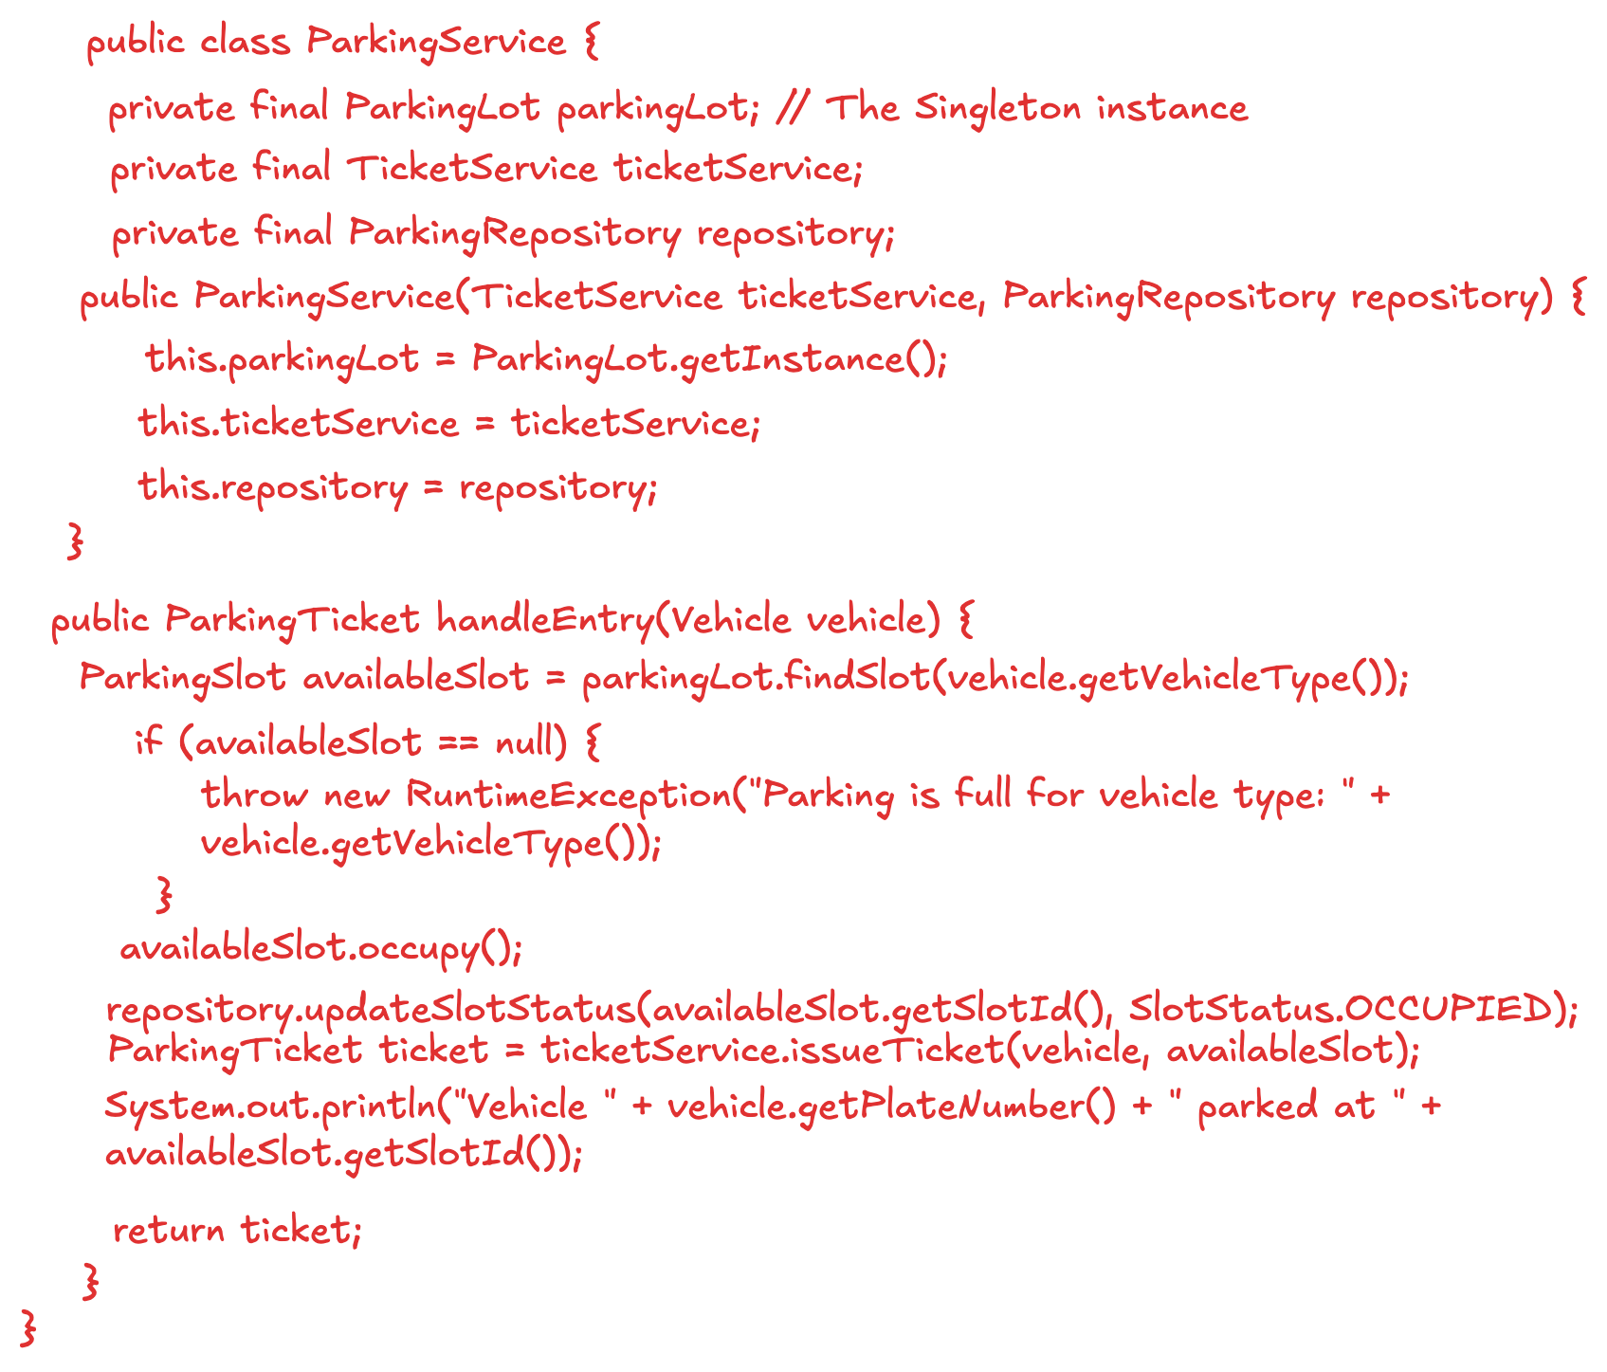
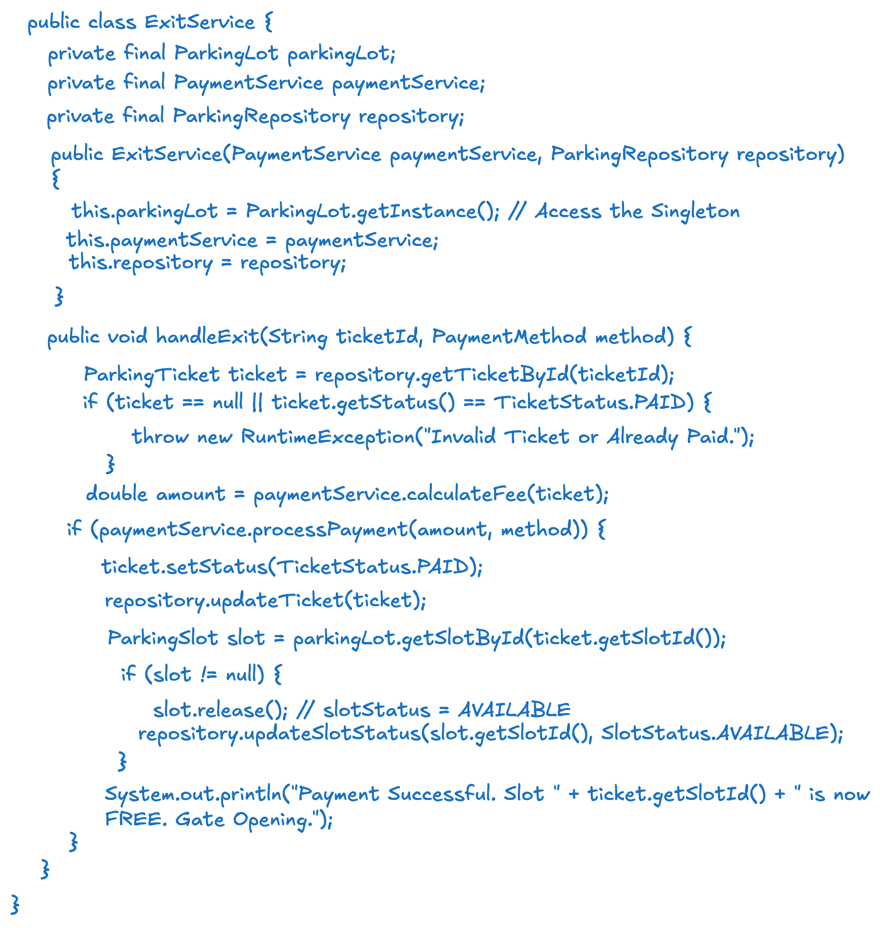
Functionality With Solid Principles

Slide 14
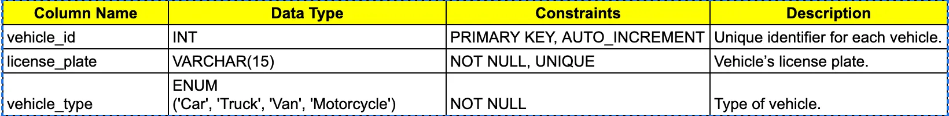
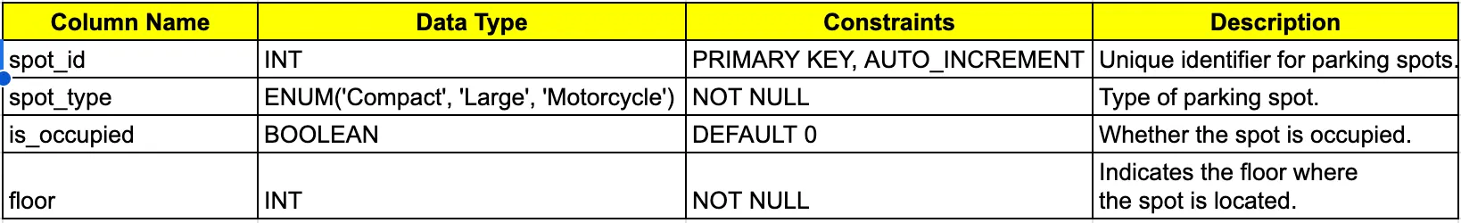
Tables Structure
Vehicle Table:
ParkingSpots Table:

Slide 15
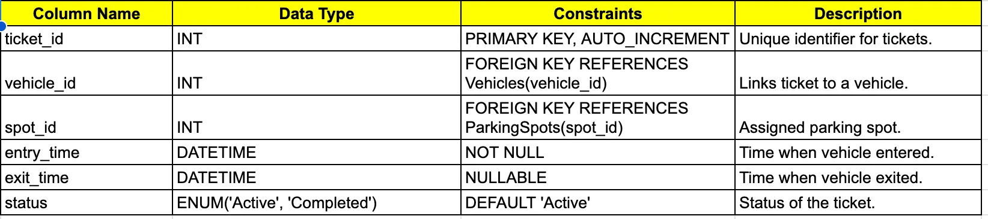
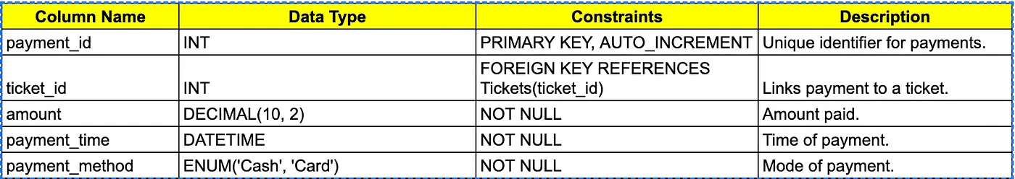
Tables Structure
Tickets Table:
Payment Table:

Slide 16
Why Do We Need Synchronization?
The Problem: Race Conditions (Two cars, one spot). {data inconsistency, dirty read, lost update}
The Solution (In-Memory): synchronized keywords or Locks or Atomic Classes in Java (only works for one server).
The Solution (Persistent): Database transactions and row-level locking, centralized locking (ideal for production)
The idea is to ensure that only one thread can update the data at a time, preventing multiple threads from modifying the same information simultaneously.

Slide 17
LLD Session II
What We Discussed Previously?
Movie Ticket System
Locking Revisited
Synchronous Vs Asynchronous System
Design Pattern (Factory, Strategy)

Slide 18
Requirement Gathering for Movie Ticket Booking
Functional:
1️⃣ One city can have multiple Cinemas/Theatres
2️⃣ Each theater can have multiple screens
3️⃣ Each screen can have multiple shows
4️⃣ Each show will have multiple seats
5️⃣ The user must able to search and see the exact current state of the theater seat status (Available vs. Occupied vs Blocked).
6️⃣ Users can select multiple seats together (e.g., A1, A2, A3).
7️⃣As soon as a user selects "Book," those seats are hidden from all other users.
8️⃣ Upon successful payment, the user receives a unique BookingID.
9️⃣ If the user's internet drops or they cancel, the seats must become "Available" again automatically after a timeout.

Slide 19
Movie Ticket Booking
Non- Functional Requirements:
1️⃣ Under no circumstances should the system allow Double Booking.
Constraints:
1️⃣ Only one user can get one seat
2️⃣ Theatres have limited number of seats

Slide 20
Object Oriented Analysis
Nouns will become classes {we are not saying them table because every db does not have tables and oops have classes}
1️⃣ City
2️⃣ Cinema/Theatre
3️⃣Screen
4️⃣Show
5️⃣ Seat
Seat → SeatType {Recliner, Sofa, regular etc }
Seat → SeatStatus { Available, Occupied, Blocked}
6️⃣ Booking
7️⃣ BookingService

Slide 21
Relationships between classes
One City —---- many Cinemas
One Cinema -—--- many Screen
One Screen —---- many Show
One Show –—--- many Seats
One Booking –—-- many Seats
One Booking –—-- one cinema
One Booking –—-- one show

Slide 22
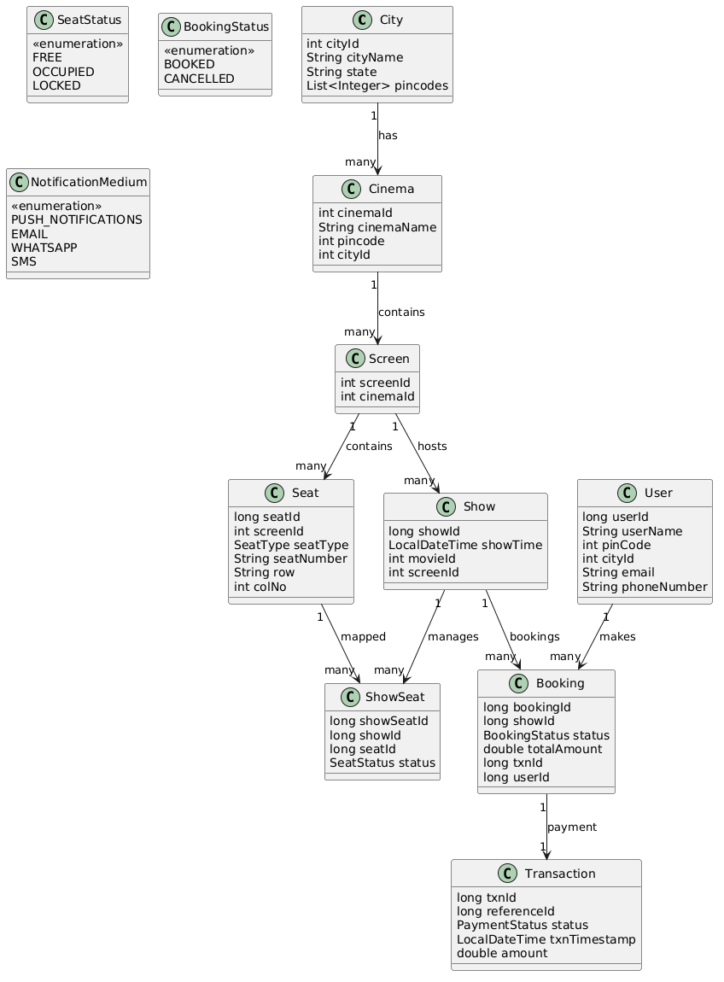
LLD (Movie Ticket Booking)

Slide 23
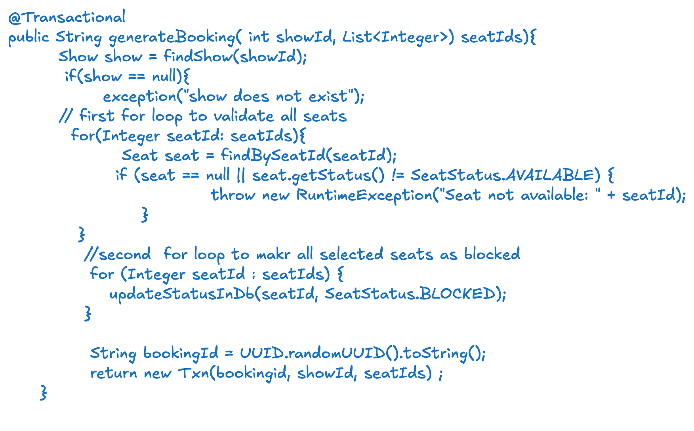
Generate Booking Flow
When updating seat status in the database, concurrency must be handled because multiple users may try to block the same seat at the same time. To prevent double booking, the seat update operation should be performed using a concurrency control mechanism such as Optimistic Locking, Atomic SQL Updates, or Database Row Locks using SELECT ... FOR UPDATE.

Slide 24
Types of Database Locking
1️⃣ Pessimistic Locking: Assumes conflicts will happen, so the system locks the resource immediately to prevent other users from modifying it. Other transactions must wait until the lock is released.
SELECT * FROM seats WHERE seat_id = 'A1' FOR UPDATE;
2️⃣ Optimistic Locking: Assumes conflicts are rare, so no lock is applied initially. Instead, we check if the data changed before updating. This is usually done using a version field.
seat_id | status | version
-------------------------
A1 | AVAILABLE | 1
UPDATE seats
SET status = 'BLOCKED', version = version +1 WHERE seat_id='A1' AND version = 1;
UPDATE seats
SET status='BLOCKED', version=version+1 WHERE seat_id='A1' AND version=1;
User1 read seat (version=1) User1 update → success → version=2
User2 read seat (version=1) User2 update → fails

Slide 25
Atomic SQL Updates
An atomic update means a database operation that happens completely or not at all, and it is executed as a single indivisible operation.No other transaction can interfere between the check and the update.
UPDATE seats SET status = 'BLOCKED' WHERE show_id = ? AND seat_id = ? AND status = 'AVAILABLE';
Internally Db checking : Check status +Update status
It will only allow one user to update the db.

Slide 26
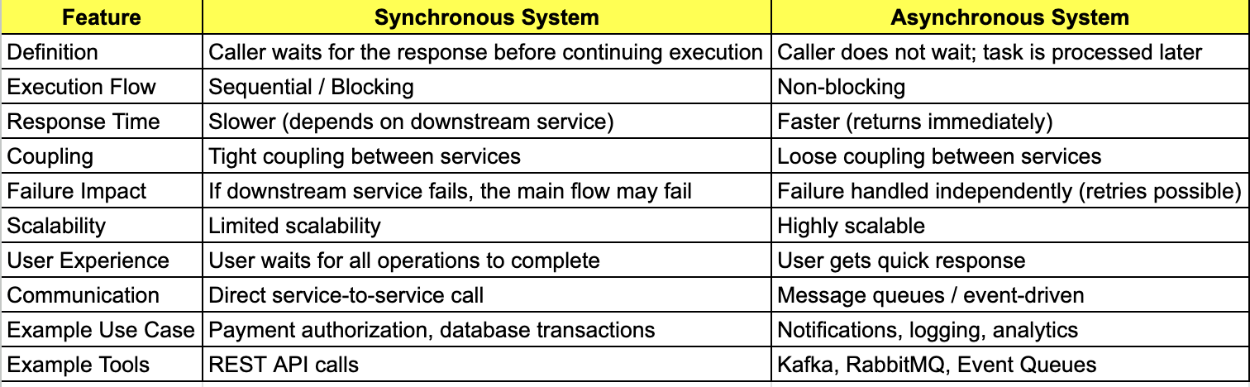
Synchronous VS Asynchronous Flow
When designing notifications after booking completion, understanding Synchronous vs Asynchronous systems is important because it affects performance, reliability, and user experience. Systems like BookMyShow usually prefer asynchronous notifications.

Slide 27
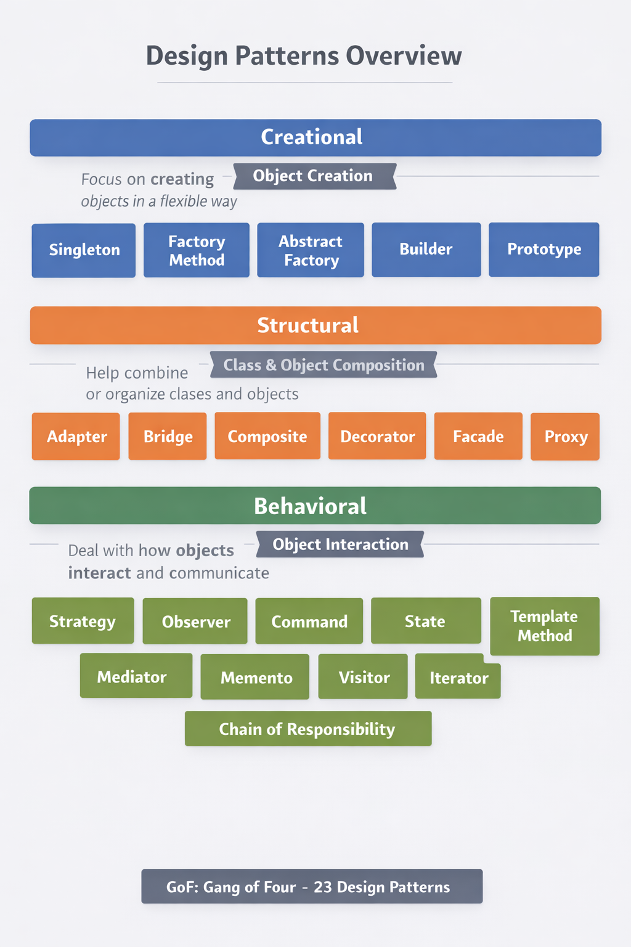
Design Patterns Overview:

Slide 28
Strategy Design Pattern
The primary goal of the Strategy pattern is to define a set of algorithms, encapsulate them in their classes, and make them interchangeable within context objects. Through this encapsulation, the Strategy pattern promotes the open/closed principle — software entities should be open for extension but closed for modification.
Eg: UPI payments, Sorting Algorithms, Payment Methods

Slide 29
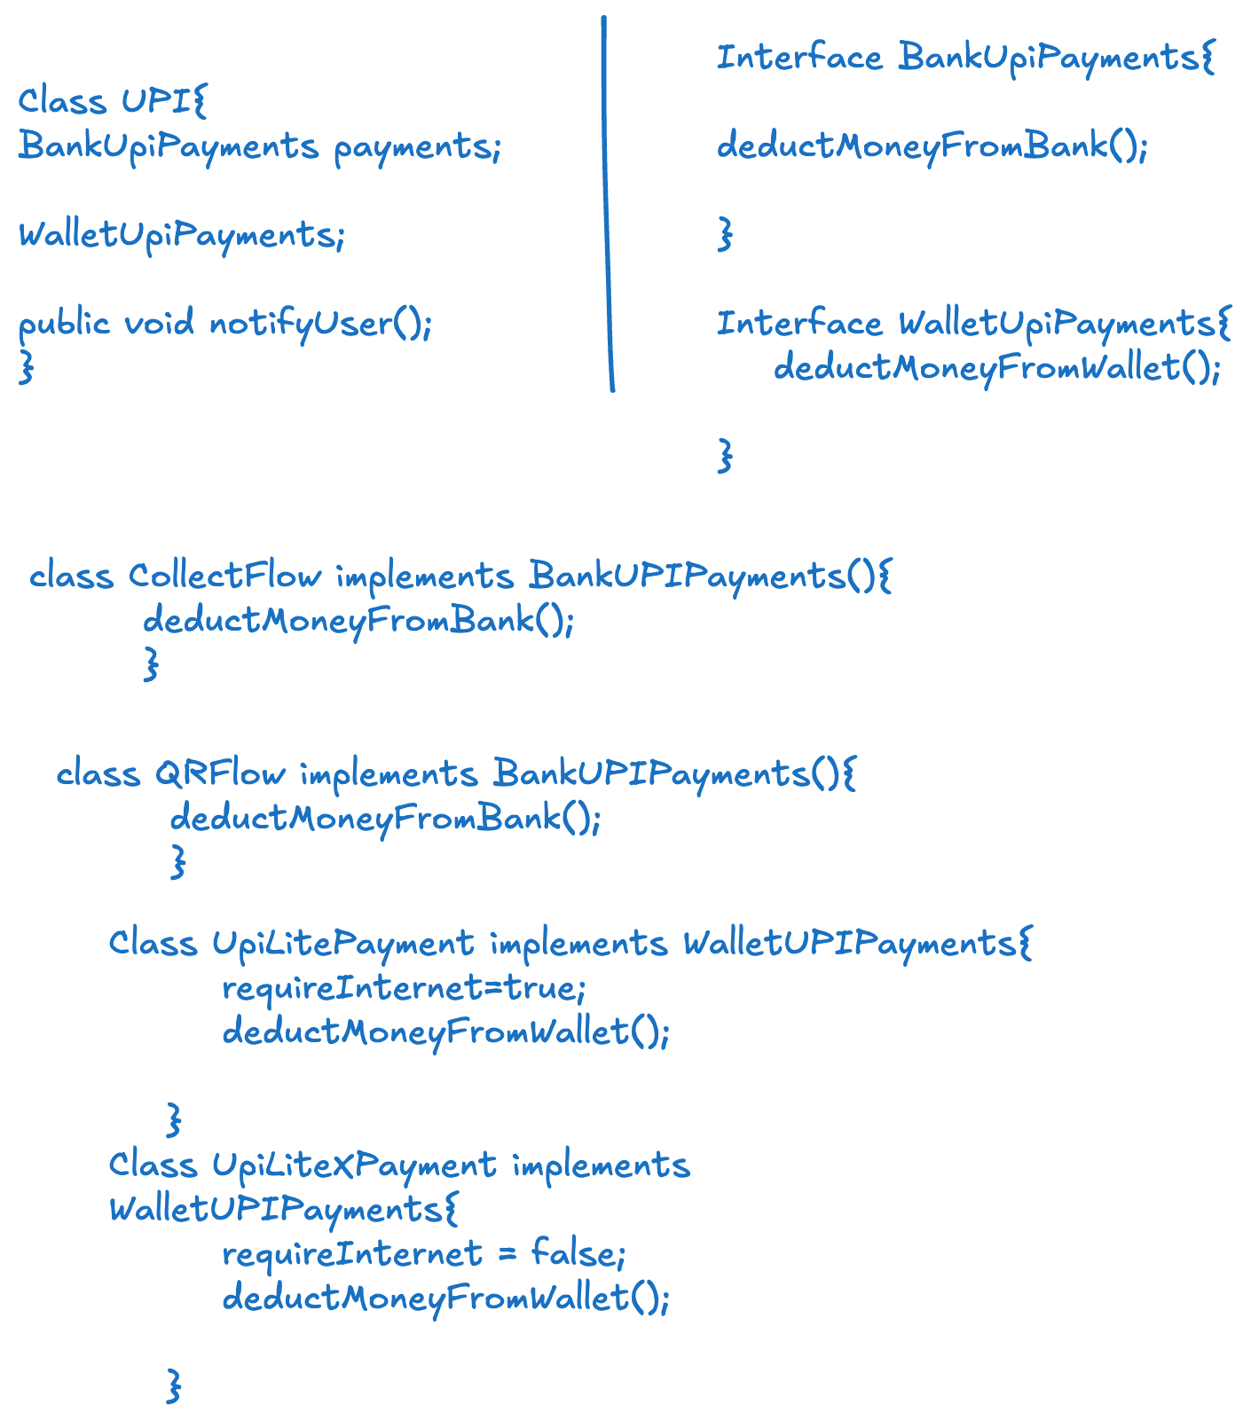
Strategy Design Pattern:

Slide 30
Factory Design Pattern
The Factory Method pattern falls under the category of creational design patterns and is widely used to create objects without specifying their exact class types. Instead of directly instantiating objects using constructors, the Factory Method pattern delegates the responsibility of object creation to subclasses, allowing for greater flexibility and extensibility.
Eg: UPI payments, Sorting Algorithms, Payment Methods

Slide 31
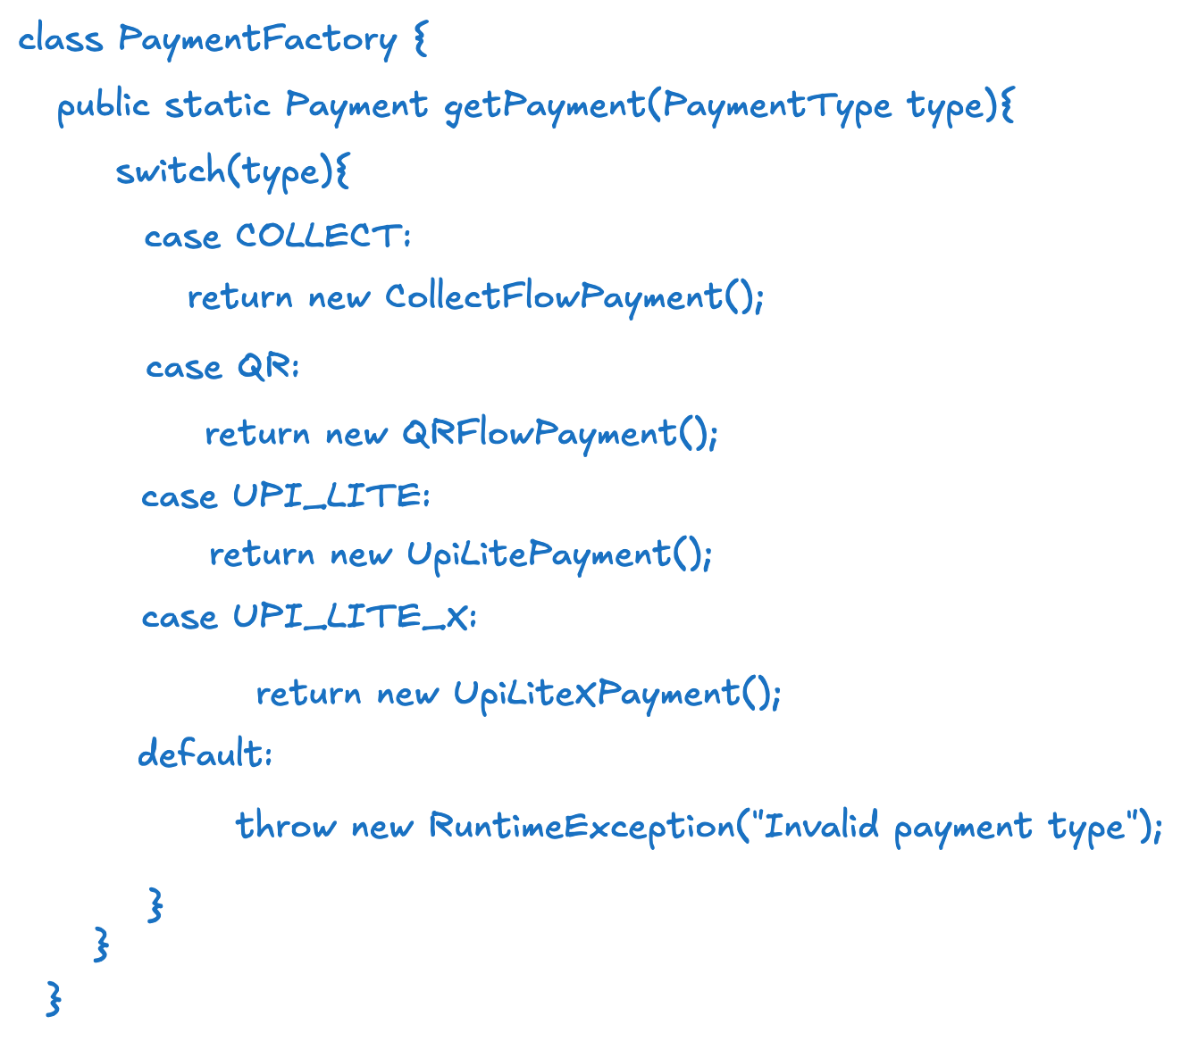
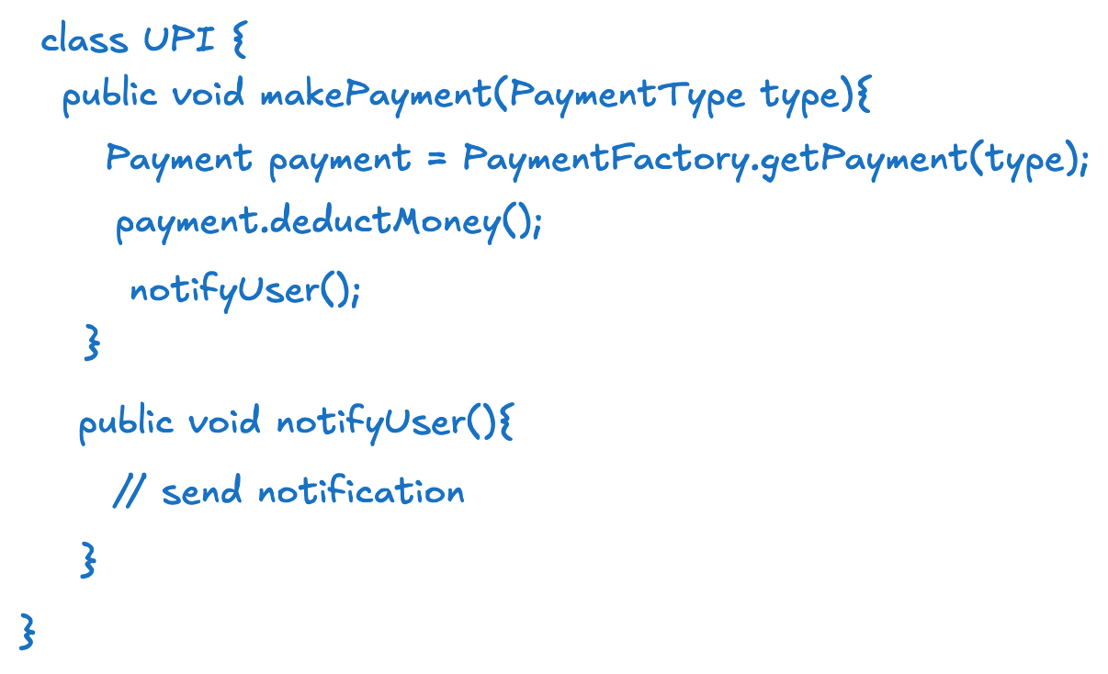
Factory Design Pattern

Slide 32
LLD Session III
What We Discussed Previously?
Chain of Responsibility Design Pattern
Template Design Pattern
Retry Mechanism in Distributed System
Scalable Systems

Slide 33
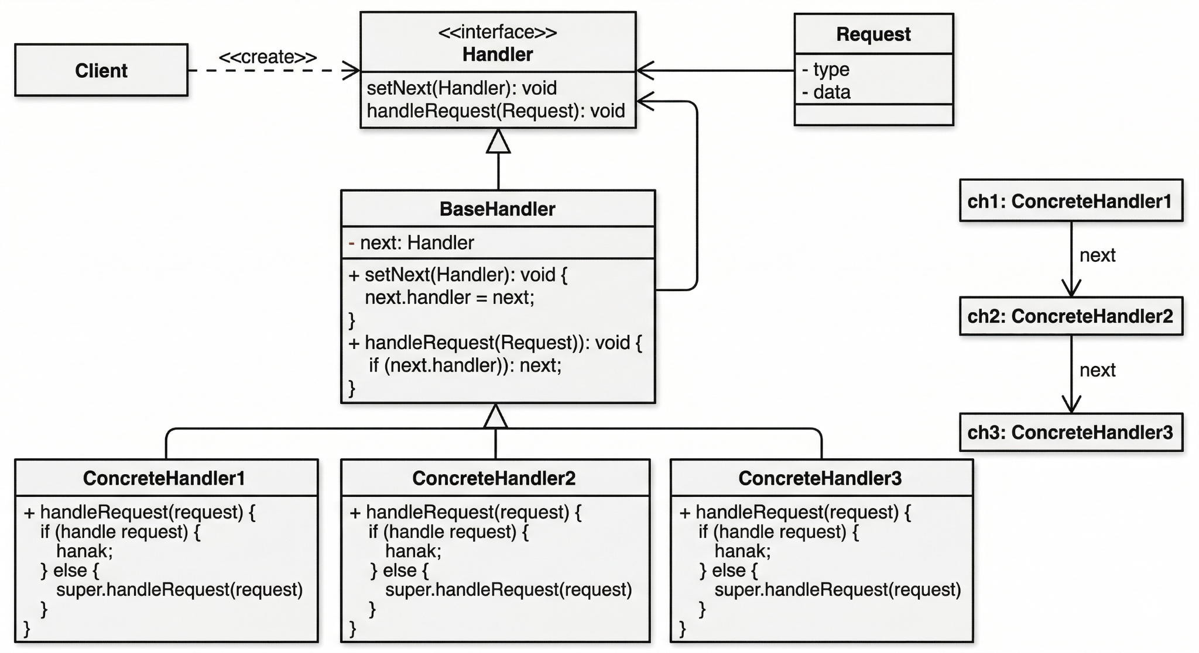
Chain Of Responsibility Design Pattern
The Chain of Responsibility (CoR) is a behavioral design pattern that allows you to pass requests along a chain of handlers. Upon receiving a request, each handler decides either to process the request or to pass it to the next handler in the chain.
Eg: ATM Dispenser, Error logs level

Slide 34
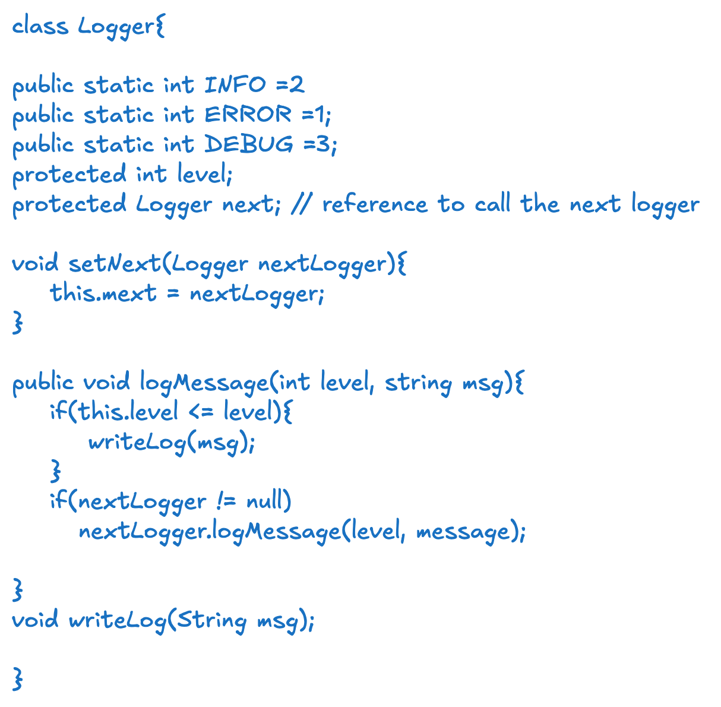
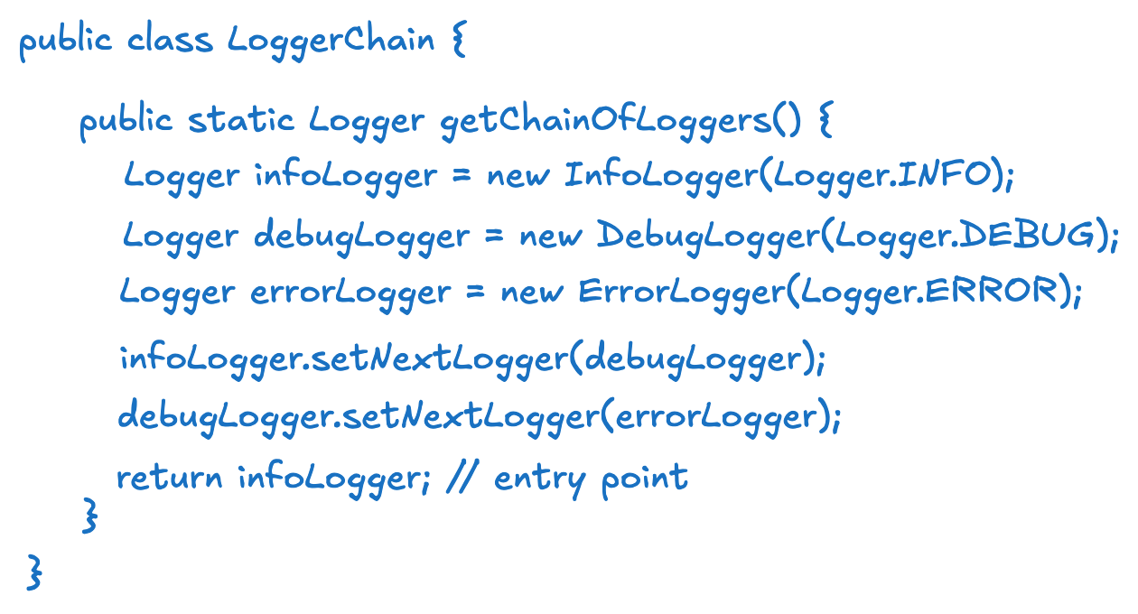
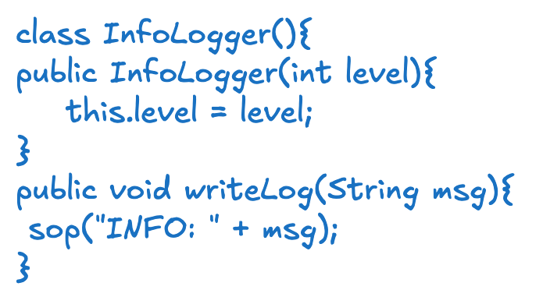
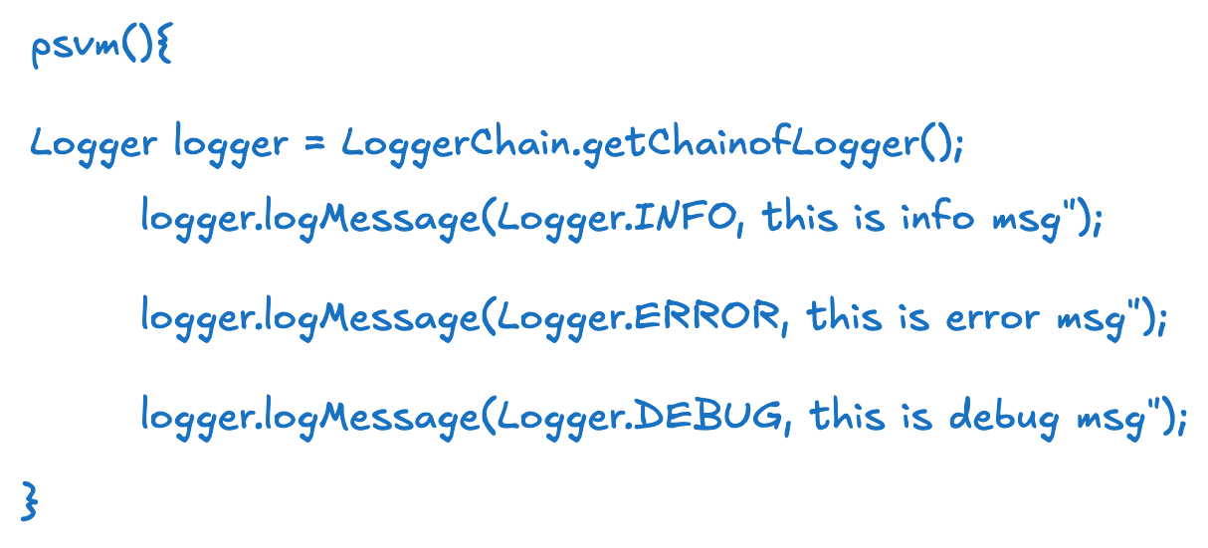
Loggers

Slide 35
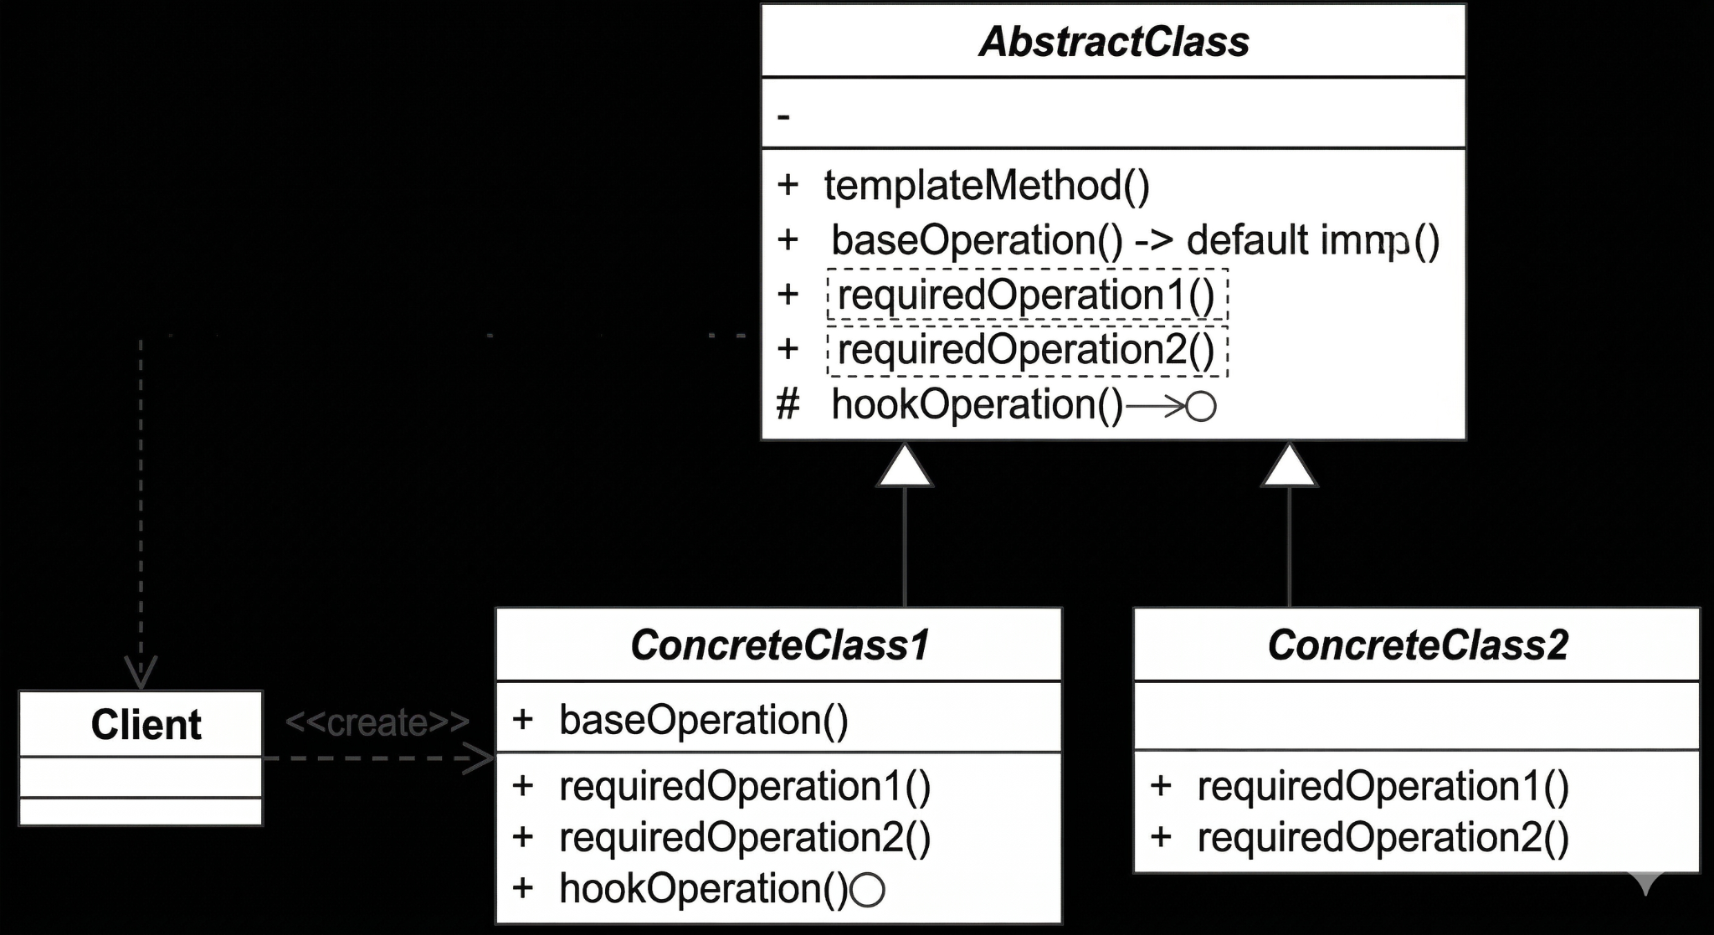
Template Design Pattern
The Template Method Design Pattern is a behavioral design pattern that defines the skeleton of an algorithm in a method, deferring some steps to subclasses. It lets subclasses redefine certain steps of an algorithm without changing the algorithm's structure.
Eg: ATM Dispenser, Error logs level

Slide 36
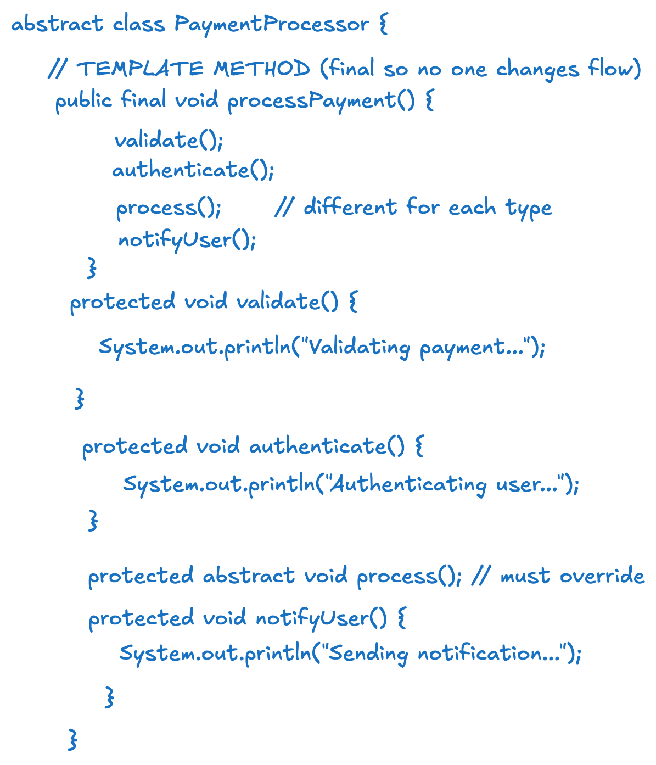
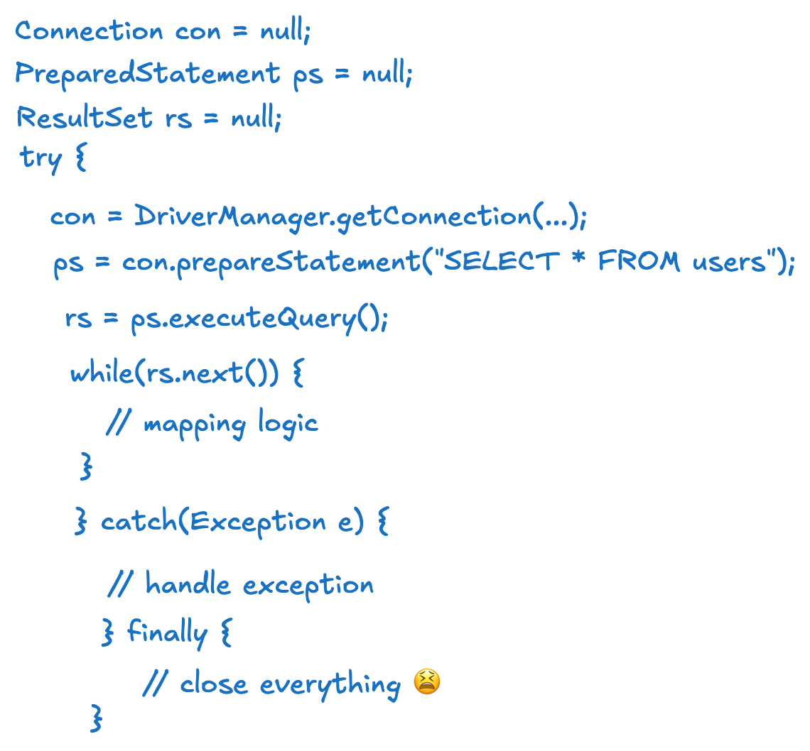
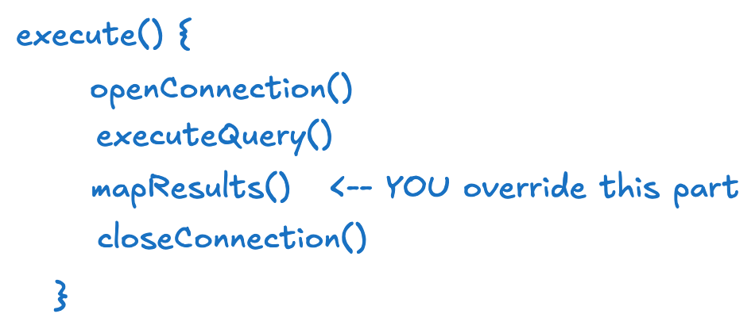
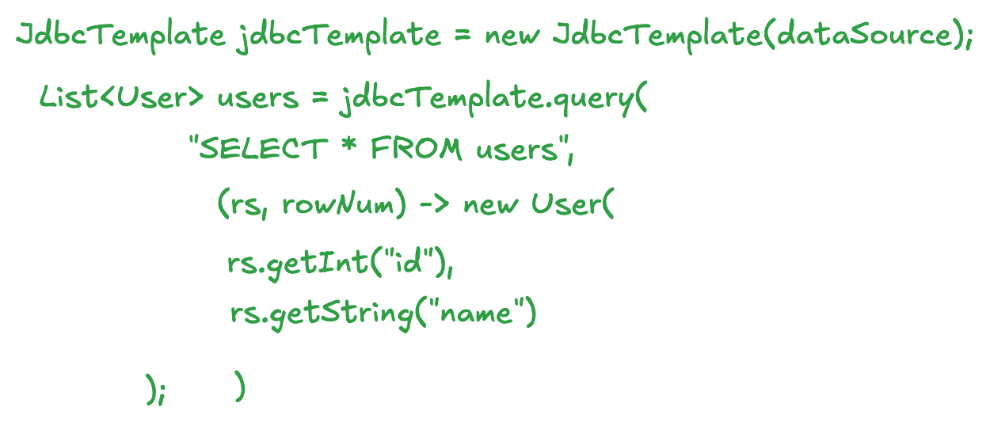
Template Design Pattern

Slide 37
Why Do We Need Retries ?
You clicked ‘Pay’… money got deducted… but order failed. What happened?
Retrying helps systems gracefully recover from these temporary failures instead of failing outright.
1. Transient Failures (Temporary)
Failures that resolve on their own after some time
Examples:
Network timeout
Temporary DB unavailability
Service overloaded (HTTP 503)
Retry can fix this

Slide 38
Failures In System
2. Permanent Failures
Failures that will NOT succeed even if retried
Examples:
Invalid input (wrong account number)
Authentication failure
Business rule failure (insufficient balance)
👉 Key idea: Retry is useless (and harmful)

Slide 39
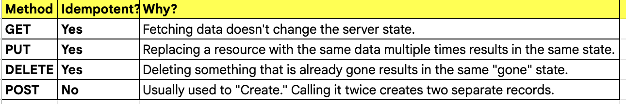
Idempotent Requests ?
An Idempotent request is an operation that can be performed multiple times without changing the result beyond the initial application. In simpler terms: If you do it once or 100 times, the state of the system remains the same as if you did it only once.

Slide 40
Golden Rules of Retry ?
Fixed Retry -> No
Retry after fixed interval (e.g., every 2 sec)
Exponential Backoff
1s → 2s → 4s → 8s… Exponential Backoff + Jitter (to avoid thundering herd)
Add randomness
Wait = random(0, base * 2^n)
there is a small chance the "random" number is 0.001 seconds. This means the client might retry almost instantly, which defeats the purpose of backing off.
The Pro Solution: Use min_wait + random(0, base * 2^n) or a "Equal Jitter" approach so that there is always some minimum breathing room.
Use max retry limit.
Ensure idempotency for retry-safe operations.

Slide 41
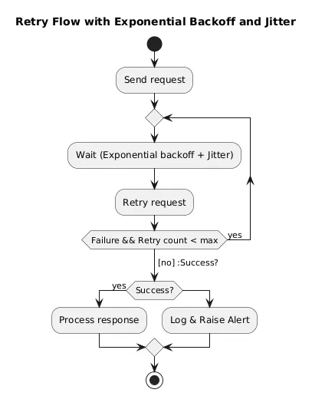
How Retry Looks Like ?
We can push the failures to dead letter
Queue for later understandings.

Slide 42
What If Payment (Post Api Fails) ?
Never Retry Blindly: A raw POST is a risk. Treat every retry as a potential duplicate operation.
Idempotency Keys: Every request must carry a Unique Identifier (e.g., request_id or idempotency_key).
Atomic Locking: Use a Distributed Lock (Redis/Redlock or DB-level row lock) to prevent "Double-Processing" during concurrent retries.
State Verification: Check before you act. Always query the current status of the transaction/resource before initiating a retry step.

Slide 43
Why No to Sync Retries?
Thread Starvation: Blocks worker threads, leading to total service hangs.
Cascading Failures: One slow dependency kills the entire upstream stack.
User Experience: Holding a "loading spinner" for 10 seconds is worse than showing an "In Progress" message.
Resource Waste: Keeps DB connections and Sockets idle.

Slide 44
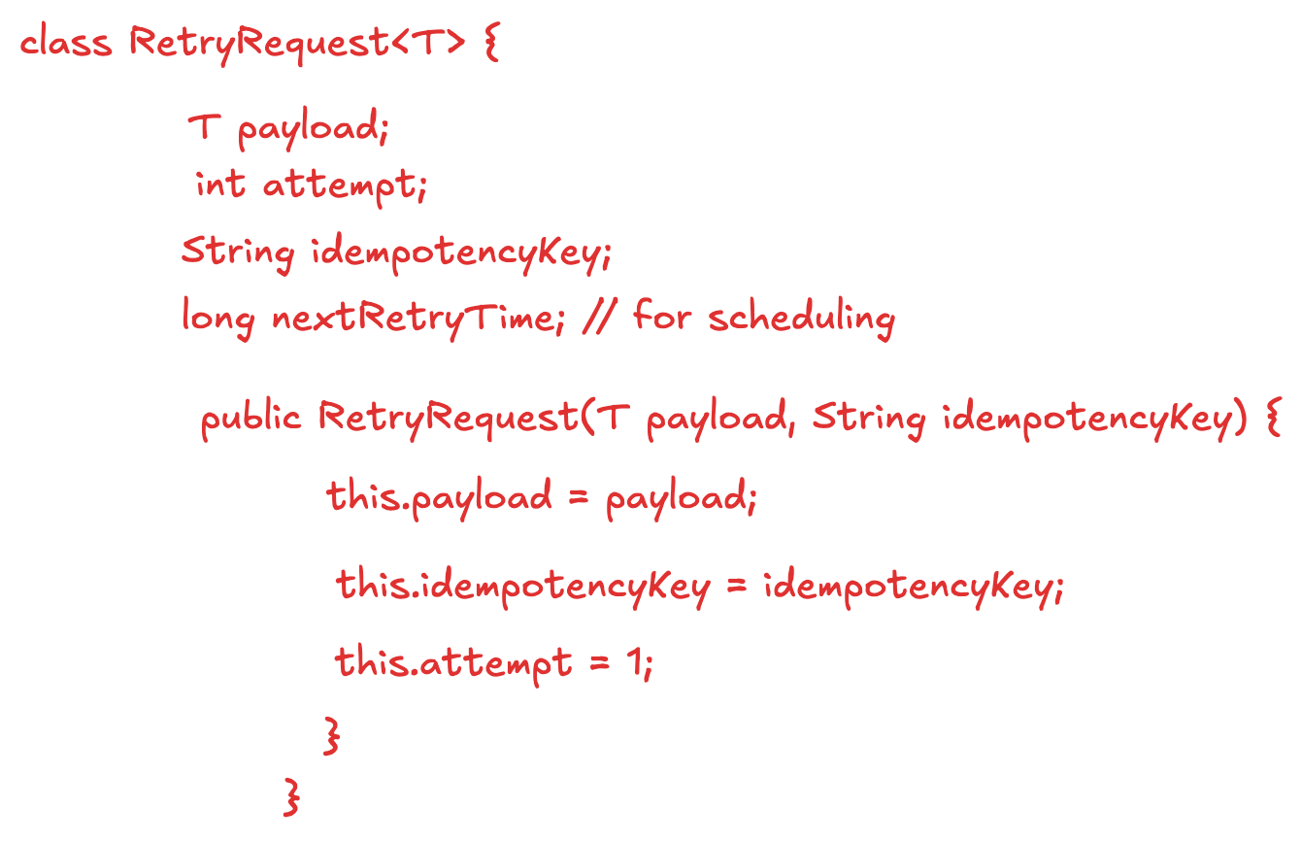
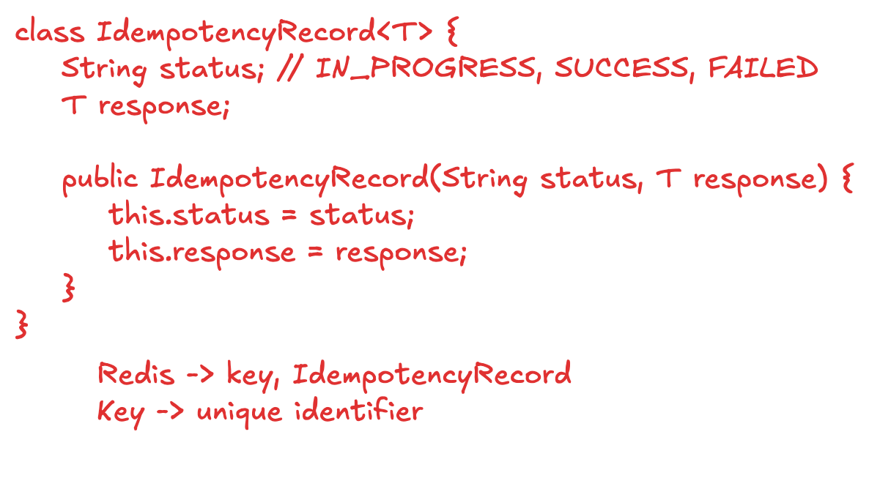
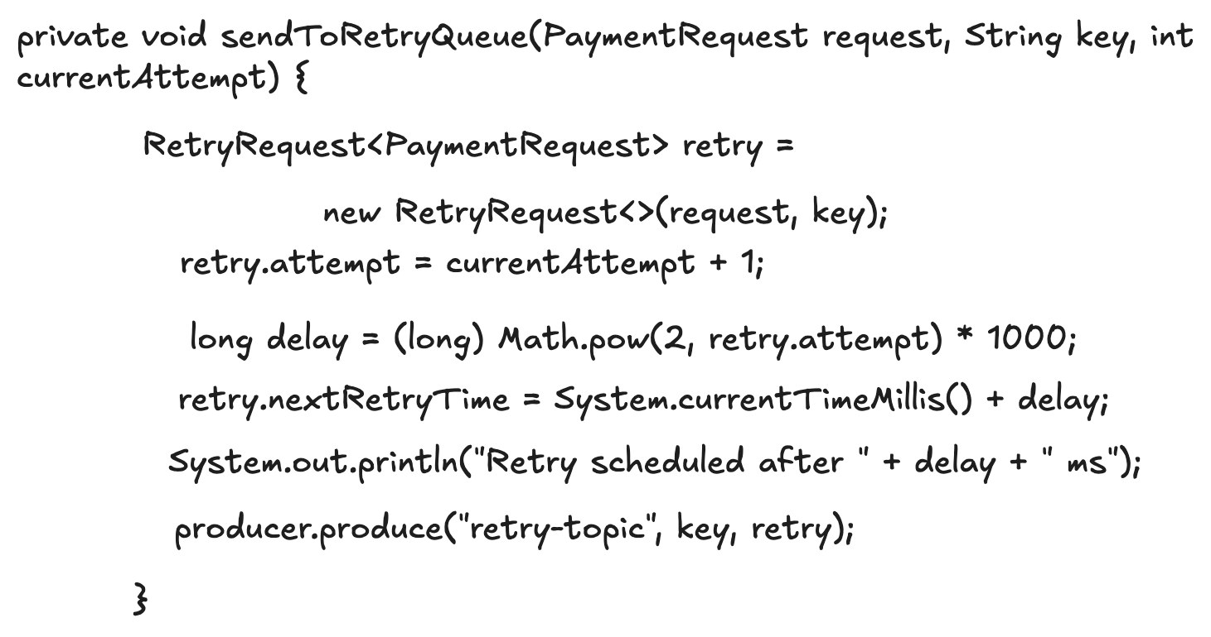
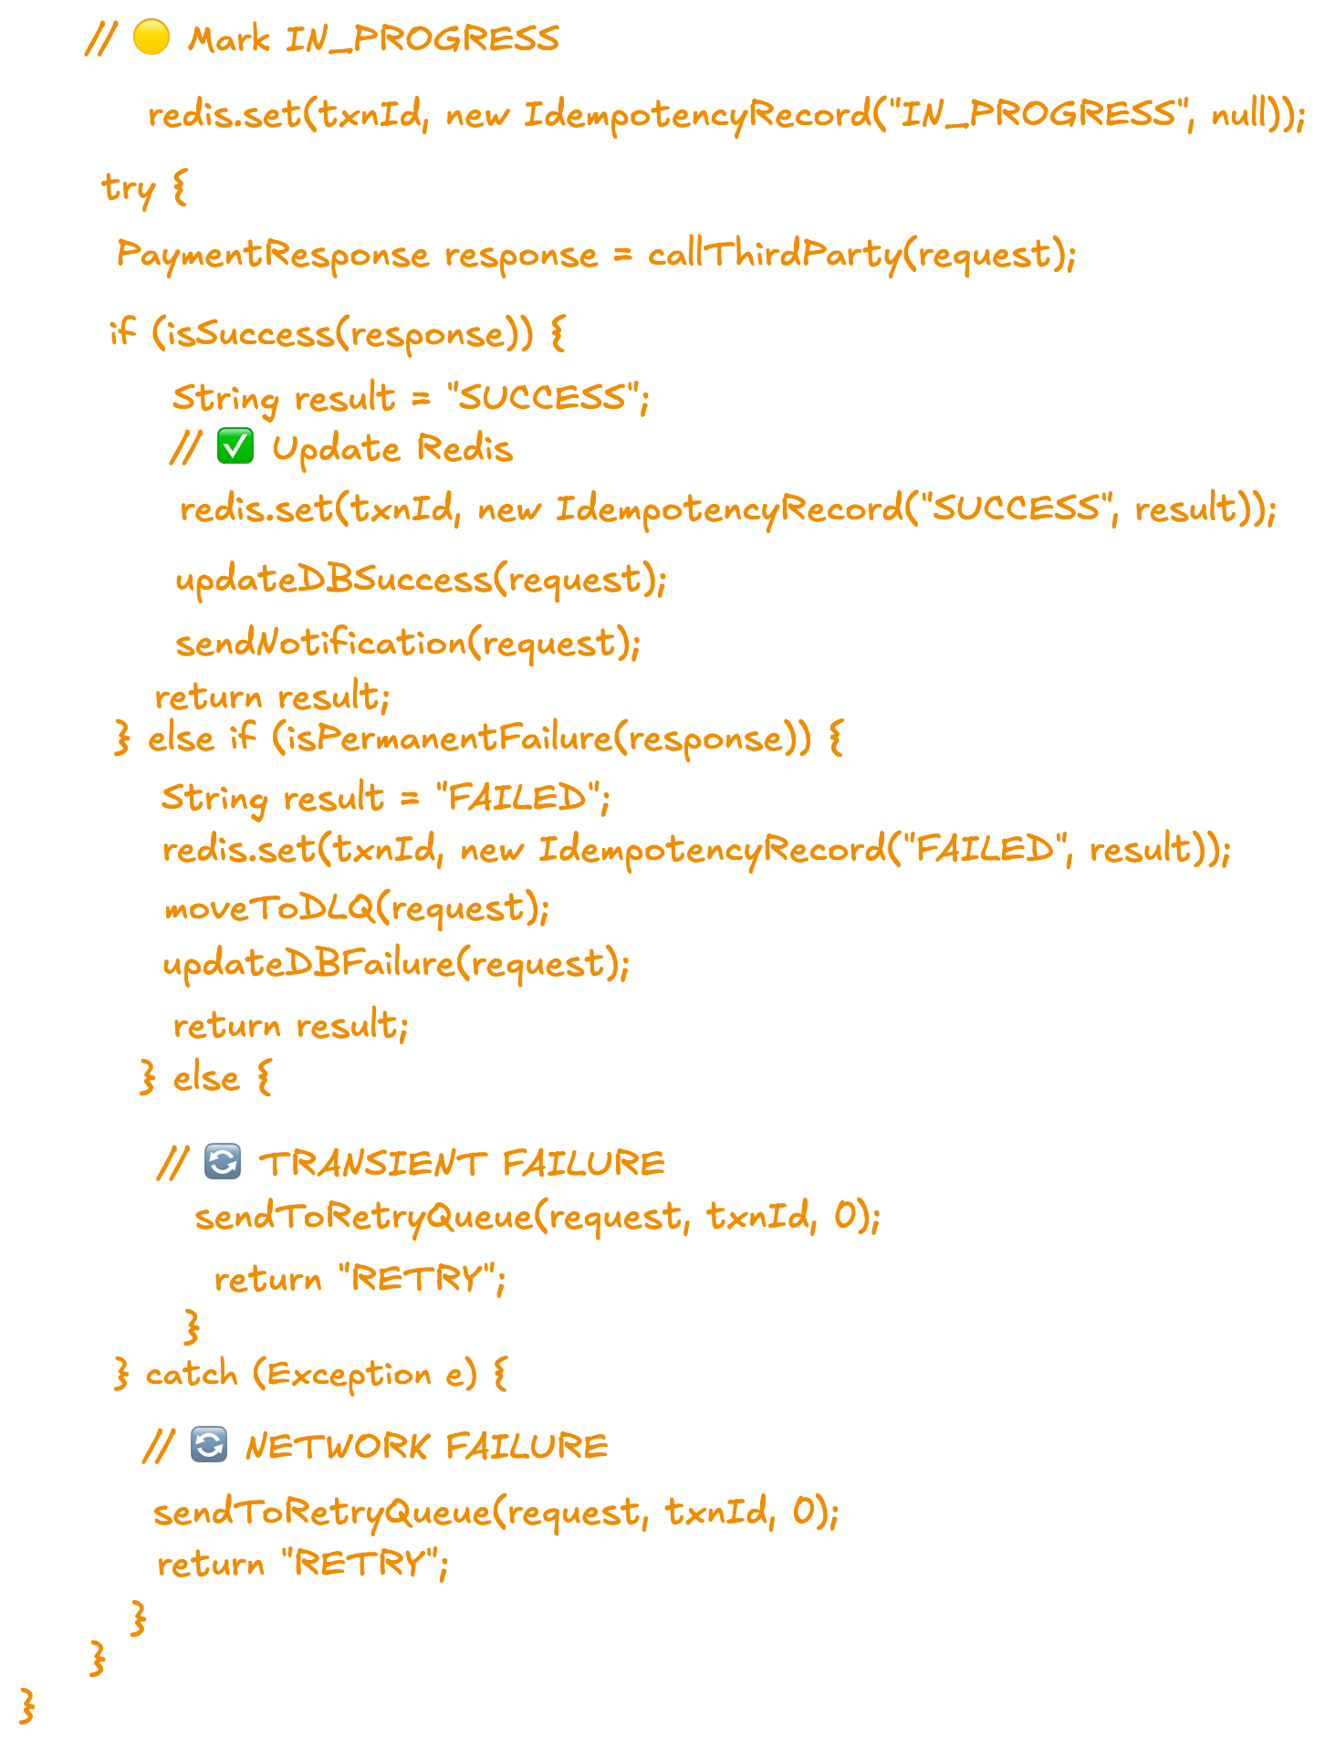
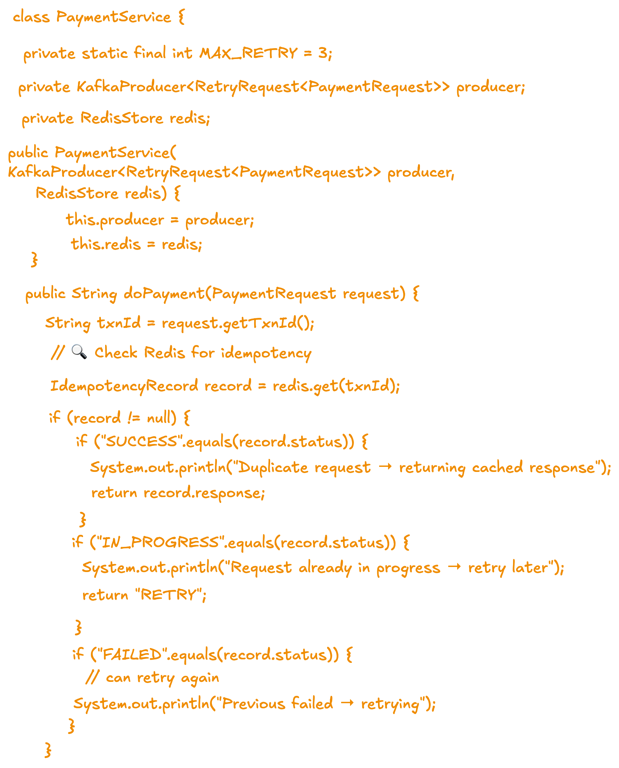
Retry Mechanism

Slide 45
Lets Talk System Components (General - HLD)
1. The Entry Point: Traffic & Delivery
CDNs, Load Balancers, and Api Gateways
2. Processing: Application & Compute
Microservices vs. Monoliths, Stateless vs. Stateful Services
3. Storage: Databases & Caching
Relational Databases (RDBMS), NoSQL Databases, Distributed Caching
4. Communication: Async & Integration
Kafka Queue, Distributed Locking
5. Resilience & Observability
Circuit Breakers, Dead Letter Queues, Monitoring & Logging

Slide 46
Scalable System Design
Scalability : Ability to handle increasing users, traffic, and data without performance degradation. We cannot achieve it only by doing one step. We have to manage it all over the system
Q: When To Scale?
Resource Exhaustion (The "Hard" Metrics)
CPU Utilization: If your application servers are consistently running above 70-80%, context switching increases, and request processing slows down.
Memory Pressure: If you see a steady climb in RAM usage or frequent Garbage Collection (GC) pauses (in languages like Java/Go), your nodes are struggling to hold the working set.
Disk I/O and Network Throughput: If the database can't write logs fast enough or the network bandwidth is saturated, the entire system throttles.
Performance Degradation (The User Experience)
Increased Latency (P99 spikes): If your average response time is 100ms but your 99th percentile jumps to 2 seconds, a subset of your users is having a terrible experience. This often points to thread contention or database bottlenecks.
Error Rates (HTTP 5xx): A spike in "504 Gateway Timeout" or "503 Service Unavailable" usually means your servers are dropping connections because the request queue is full.

Slide 47
Scalable System Design
Database Bottlenecks:
Connection Pool Exhaustion: Your application can't talk to the DB because all available connections are taken.
Slow Queries: As the dataset grows, indexes might no longer fit in memory (Buffer Pool), causing the DB to hit the disk more often.
Lock Contention: Too many processes trying to update the same rows simultaneously (common in high-concurrency systems like inventory management).

Slide 48
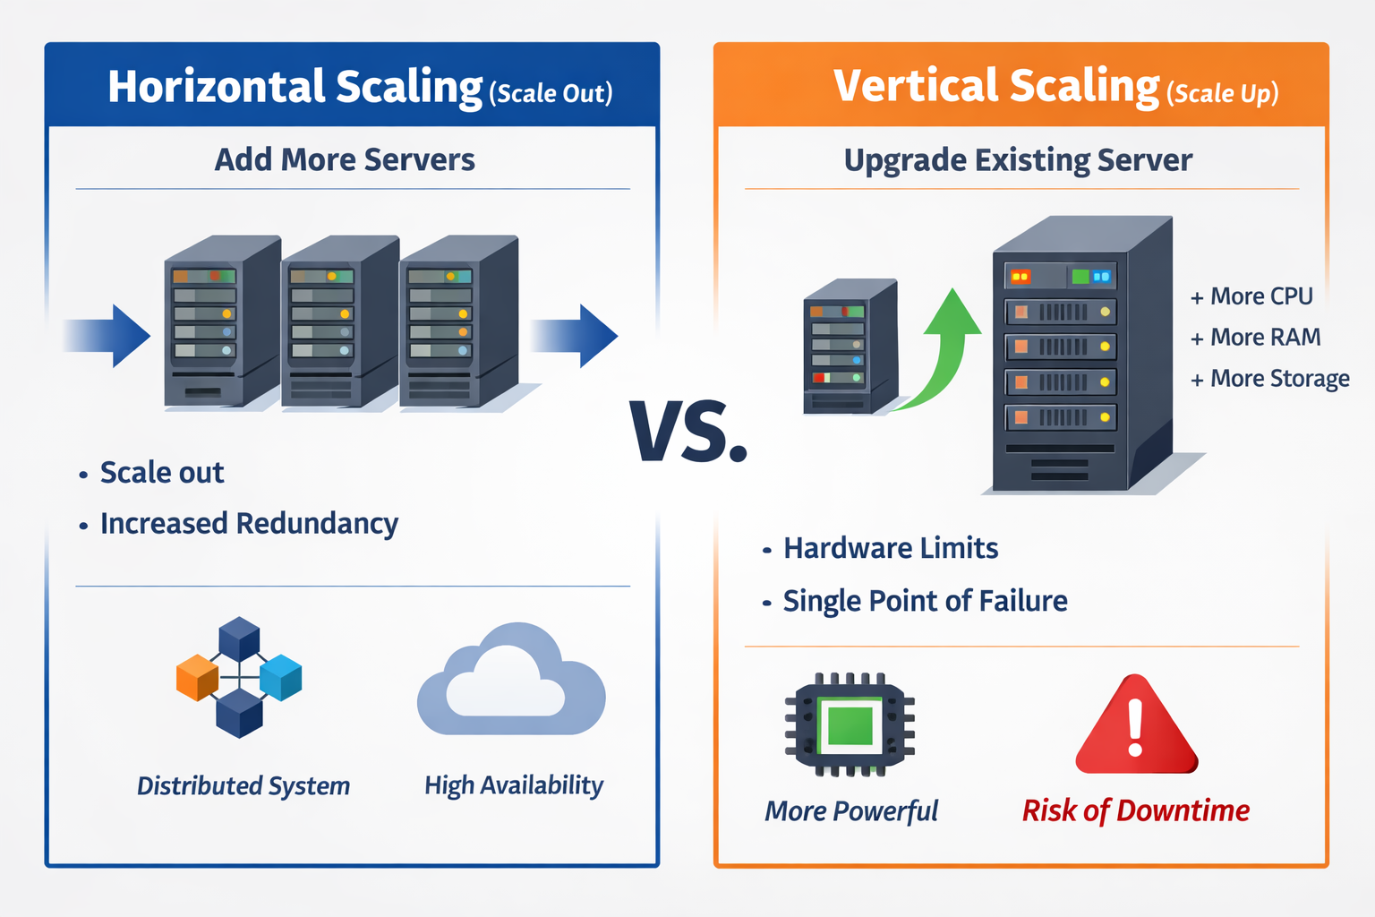
Horizontal VS Vertical Scaling

Slide 49
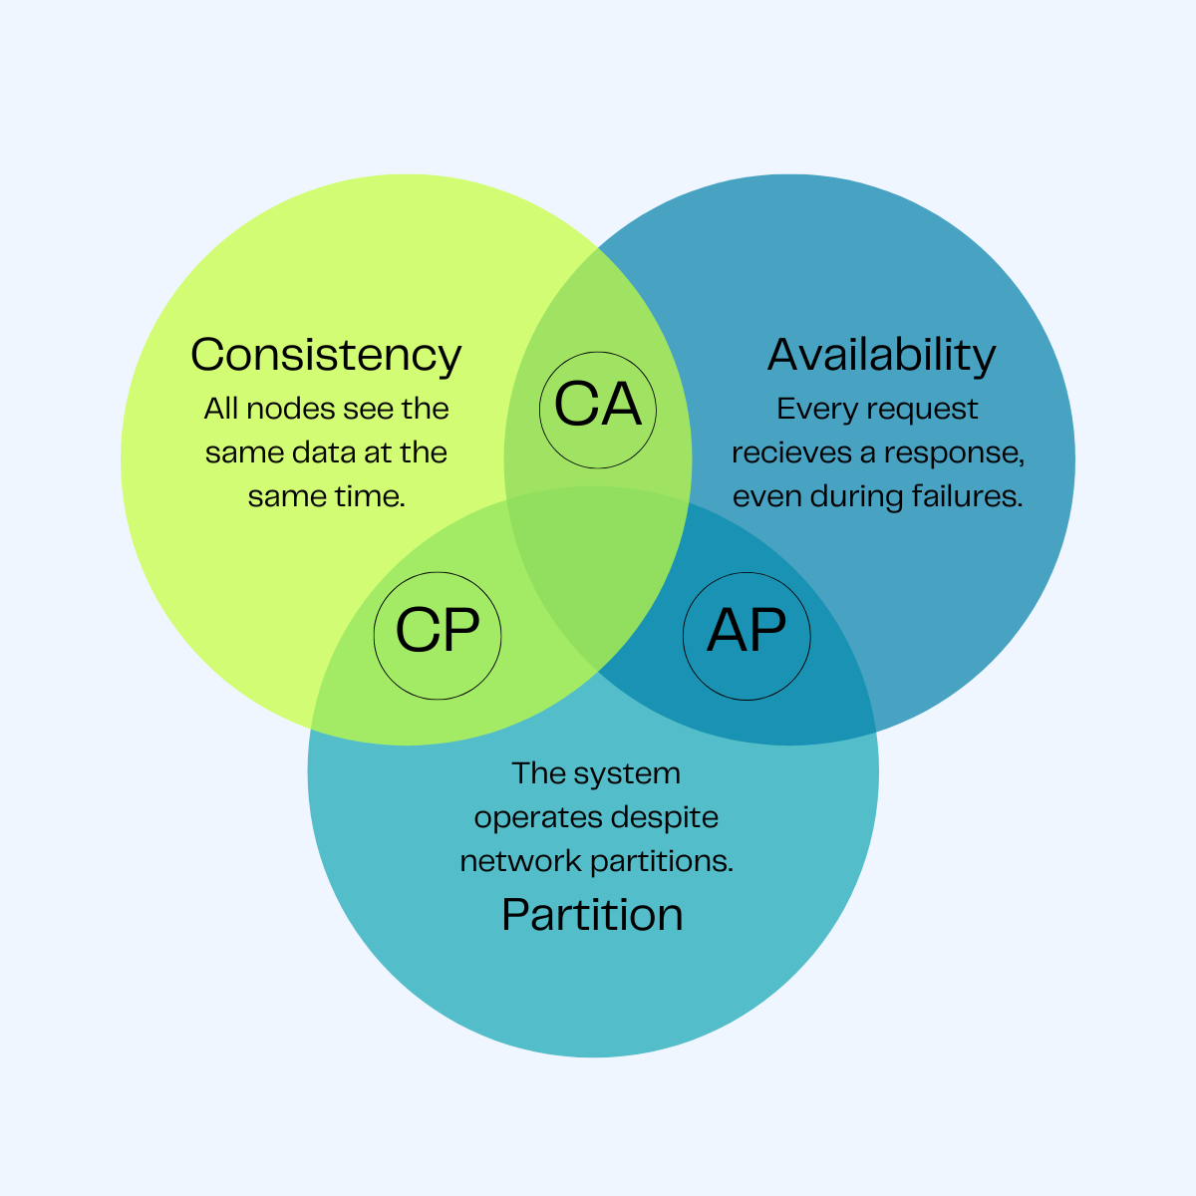
Databases Decisions
1. The Data Model (Shape of the Data)
How is the data structured, and how does it relate to other data?
Relational (SQL): Use this if your data is highly structured and you need complex joins. Perfect for Payment Systems or User Profiles where data integrity is non-negotiable.
Document (NoSQL - MongoDB): Best for unstructured or rapidly evolving schemas (e.g., Product Catalogs or User Preferences). It stores data in JSON-like formats.
Key-Value (Redis/DynamoDB): The simplest form. Use this for Session Management or Distributed Caching where you only need to retrieve data by a unique ID.
Graph (Neo4j): If the relationship between data points is more important than the data itself (e.g., Social Networks or Fraud Detection).

Slide 50
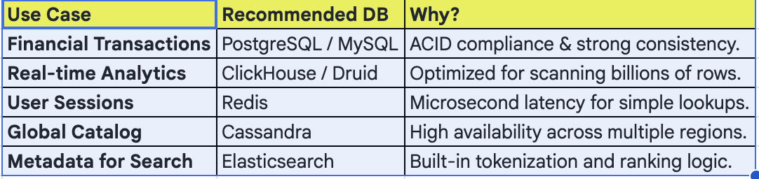
Choose DB
2. Access Patterns (Read vs. Write)
Analyze how the system will interact with the data.
Read-Heavy: If you have 99% reads and 1% writes (like a News Feed), prioritize databases with strong caching layers or those that support easy Read Replicas.
Write-Heavy: If you are ingesting millions of sensor logs or tracking GPS coordinates for a Logistics App, use a LSM-Tree based database like Cassandra or ScyllaDB which are optimized for high-speed writes.
Search-Heavy: If users need to search by text, fuzzy matching, or multiple filters (like an E-commerce Search), offload this to a search engine like Elasticsearch.

Slide 51
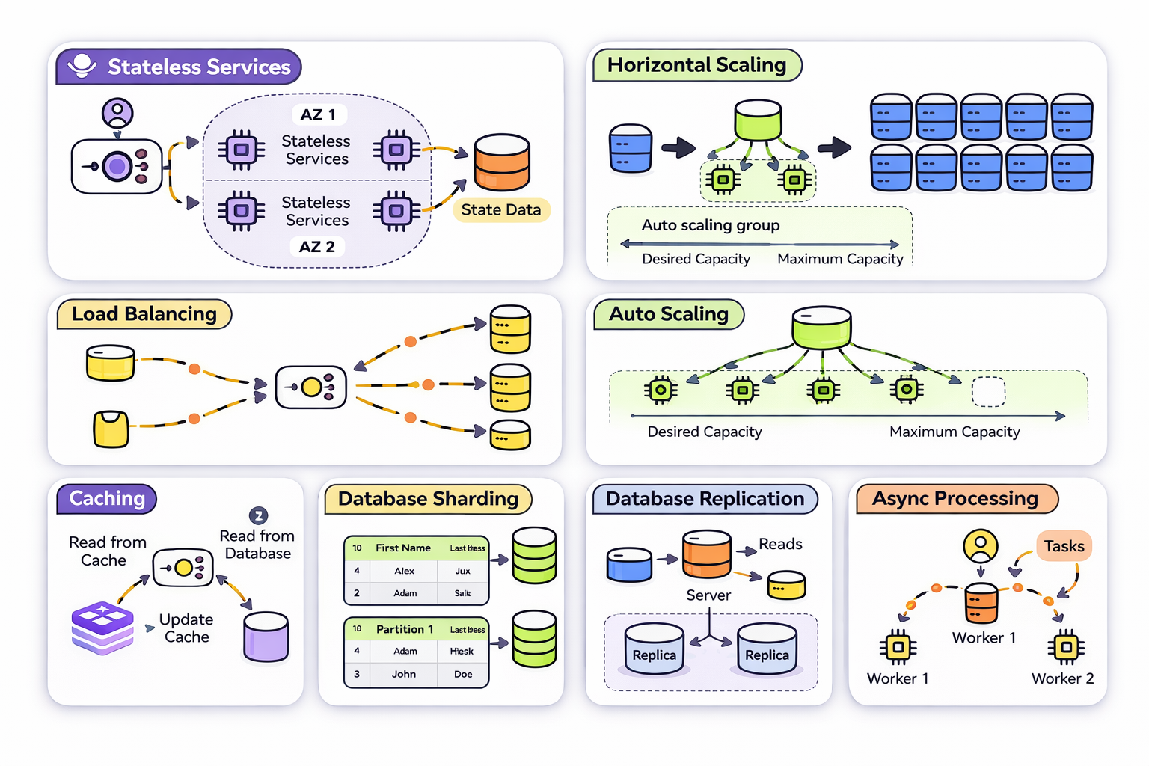
Important Terminologies

Slide 52
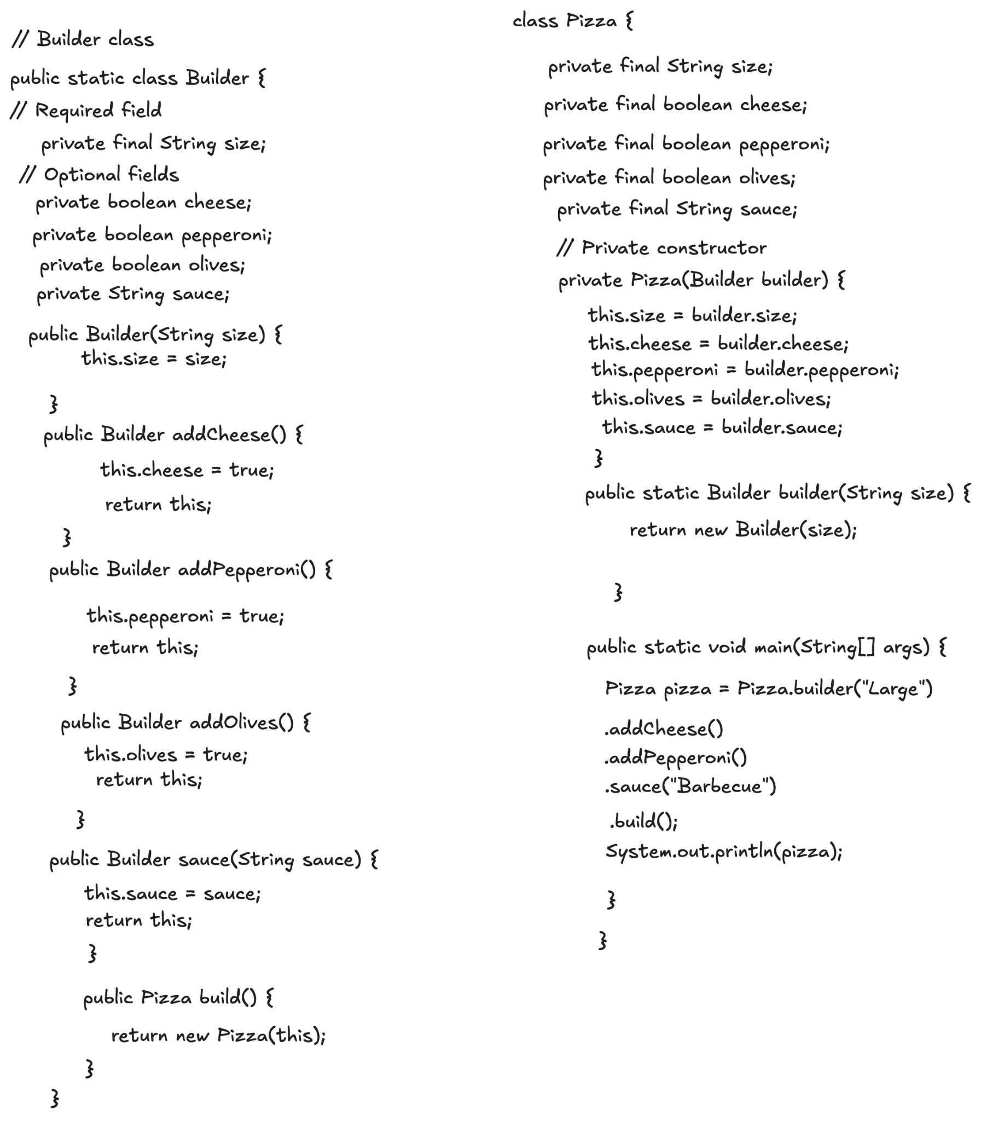
Builder Design Pattern
The Builder Design Pattern is a creational pattern used to construct complex objects step-by-step. It separates the construction of an object from its representation, allowing you to create different flavors or configurations of an object using the same building process.

Slide 53
Questions?

Slide 54
